Slide 1
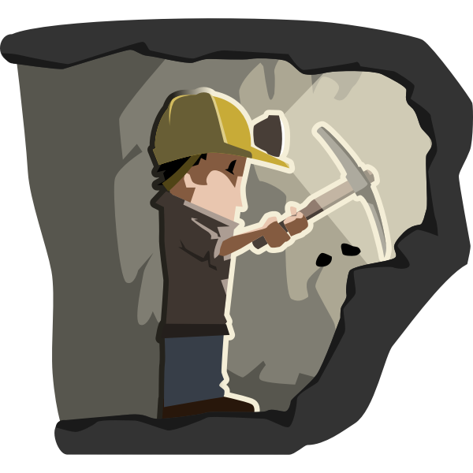
Human Interaction with the Rock Cycle.
Mining
Define the following terms
Mining – extraction of valuable material from the earth
Rock - a solid collection of minerals
Mineral - a naturally occurring substance with distinctive chemical and physical properties, composition and atomic structure.
Metal – iron, copper, zinc, lithium, aluminium
Ore – rock which contains valuable minerals
Raw Material – input for manufacturing

Slide 2
Use of Mining Outputs in Everyday Life
Phone (Copper, Silica, Lithium, Iron, Bauxite)
Bicycle (Aluminium, steel, graphite, titanium)
Soccer Ball (Mica, Cobalt, zinc, silicon, potash)
https://www.youtube.com/watch?v=S4jsrqxl11A&list=PLR_AkCK1aBhlk-IeTvpzDtjrpmB6s_phO&index=6
10 things about metals

Slide 3
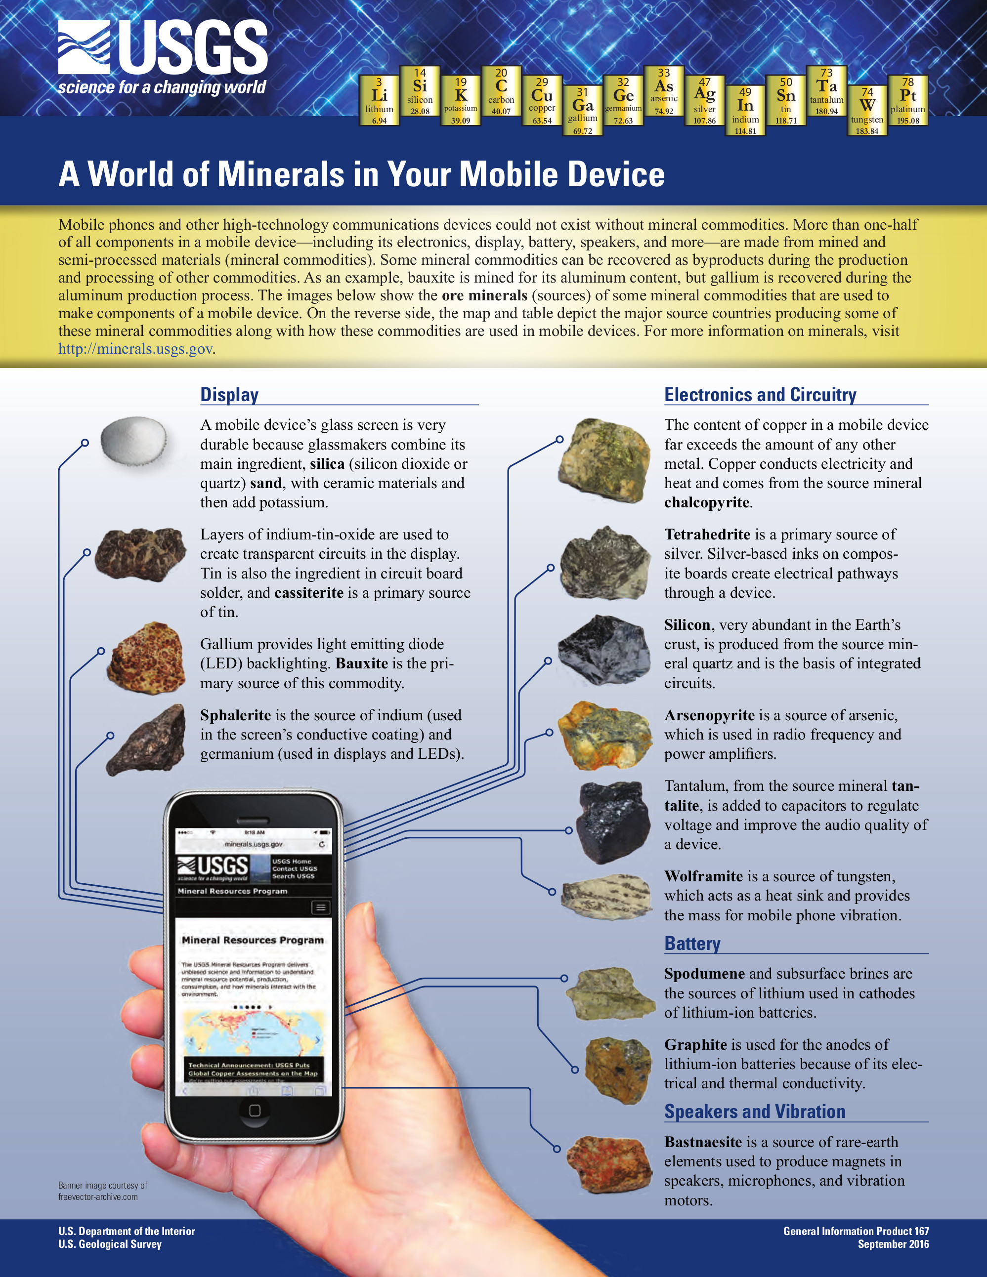

Slide 4
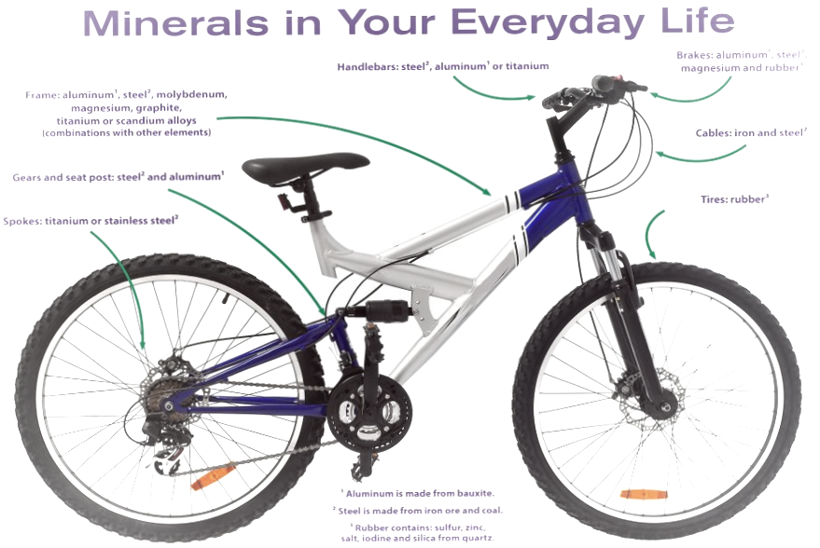

Slide 5
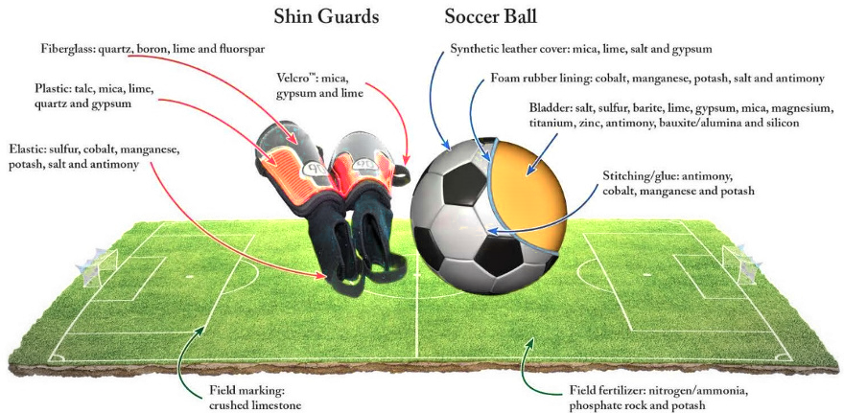

Slide 6
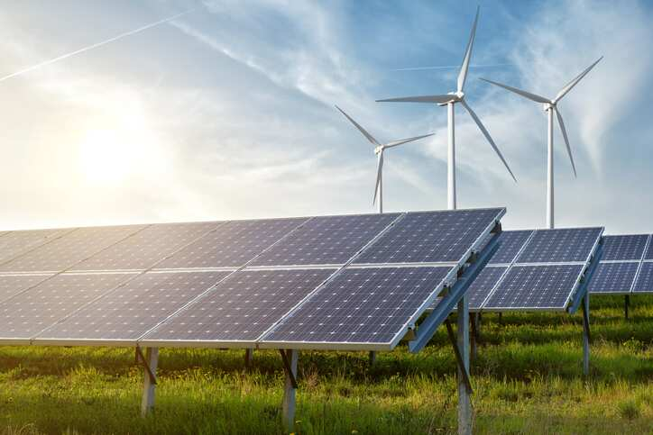
Class Discussion.
Introduce the need to develop renewable energy resources, link to climate change and global warming.
Examine the types of renewable energies available.
Discuss the best options for Ireland.
Wind (onshore and offshore).
Solar.
Make the link between construction, operation of these to key outputs from Mining activities.

Slide 7
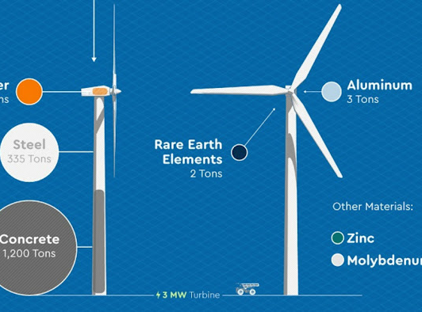
Construction and operation of a windfarm is not possible without Mining Inputs.

Slide 8
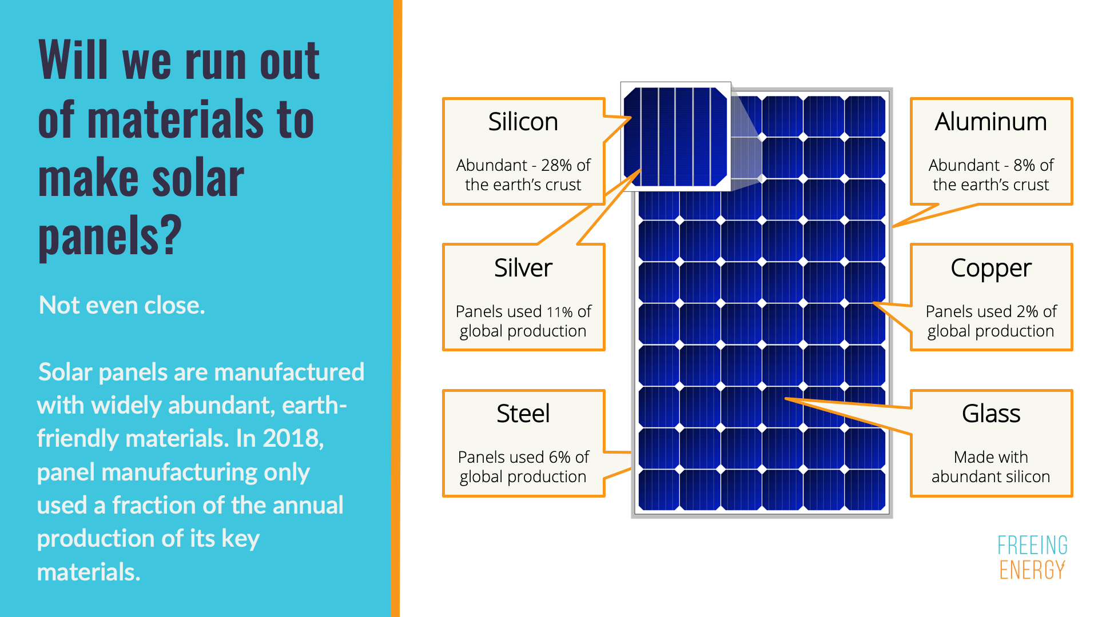
Construction and operation of Solar panels is not possible without Mining Inputs.

Slide 9
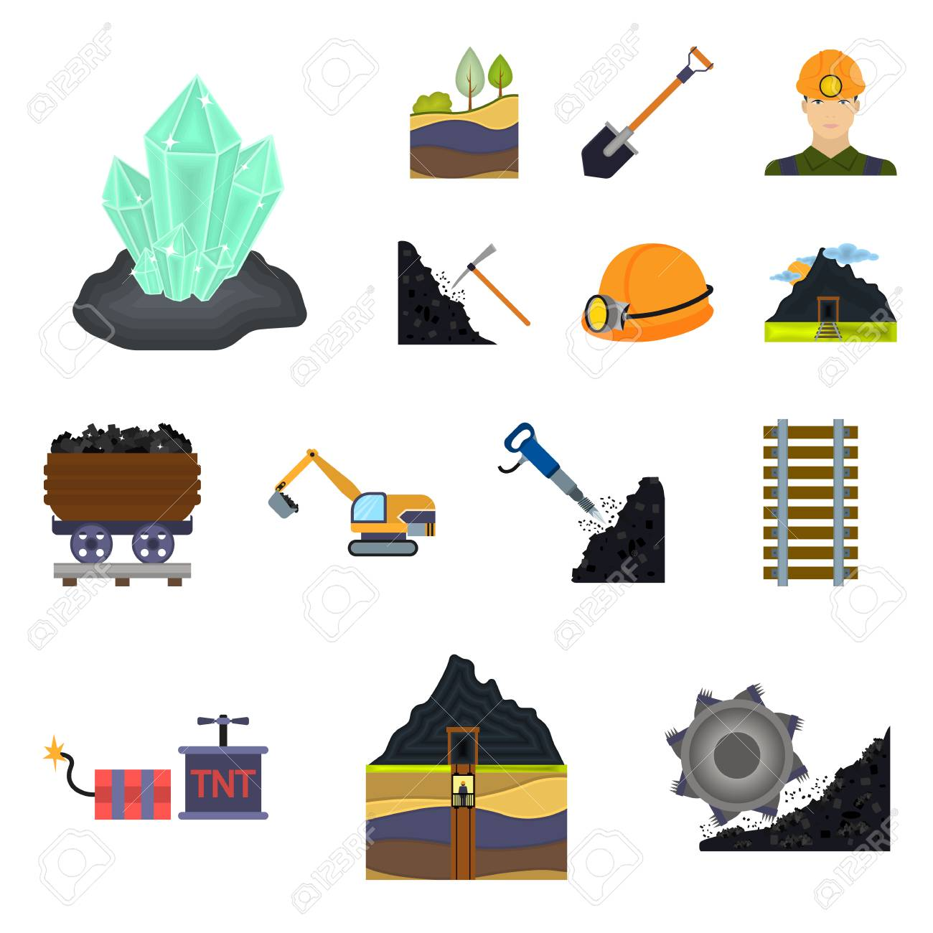
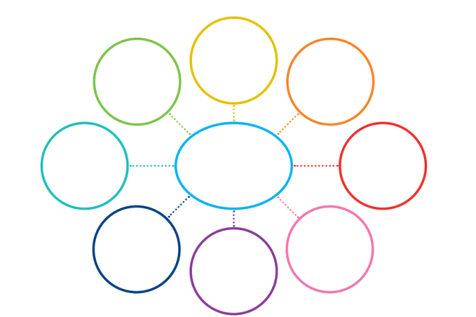
Class Activity – Ask students to design a memory map to illustrate their perceptions of Mining as an activity.

Slide 10
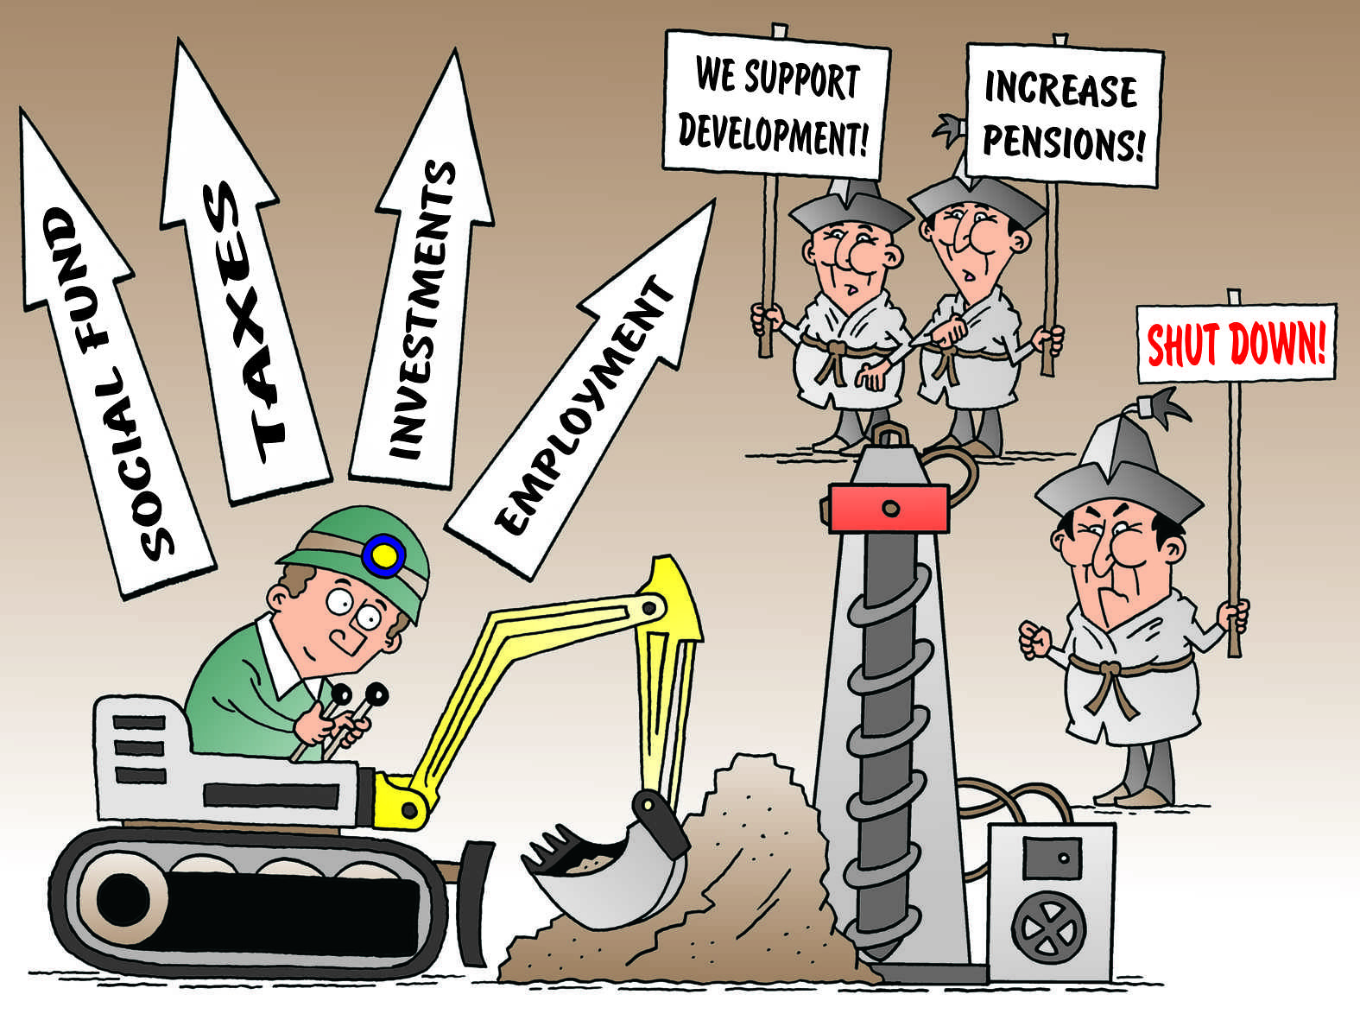
From that activity – create a list of perceptions using the guidelines of Advantages and Disadvantage.
Use headings of Economic, Social and Environmental.

Slide 11
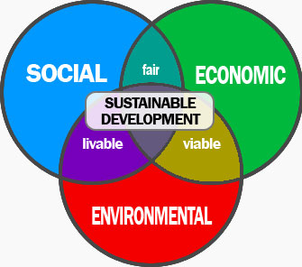
Concept of Sustainable Development.
“Development which meets the needs of current generations without compromising the ability of future generations to meet their own needs”
Bruntland Commission 1987.

Slide 12
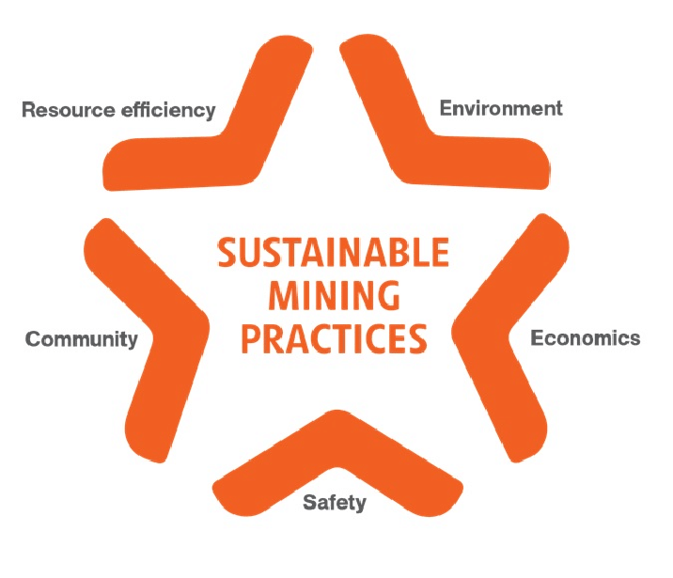
Sustainable Mining – resource extraction undertaken in a manner which seeks to improve social, economic and environmental outcomes.
“Before you run in you must plan how you will walk out”
Overall sustainable mining is possible if efforts are made to enhance the benefits of mining activity and to the reduce or mitigate negative impacts.
Involvement of the local community in the process allows companies a “social licence to operate”.

Slide 13
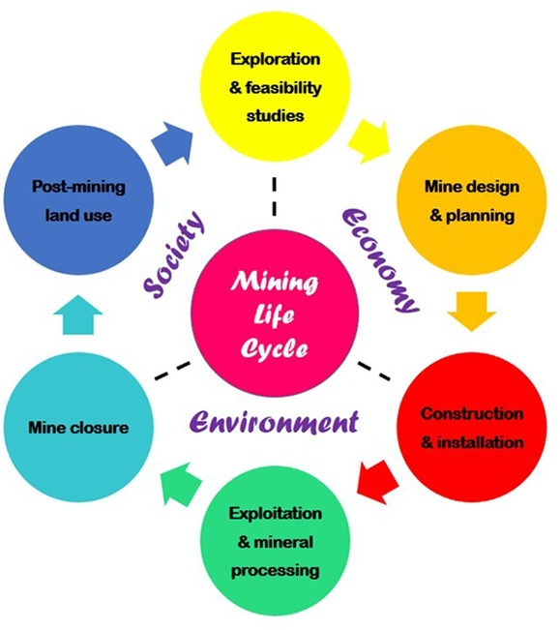
Life Cycle of Mining
Finite resource
Resource depletion
Limited lifespan
Eventual closure
Post-mining land use

Slide 14
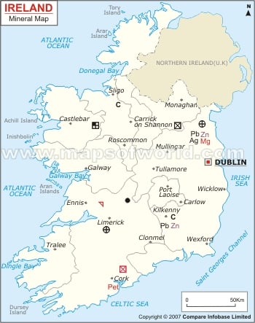
History of Mining In Ireland
Ireland has a rich history with respect to mining and mineral exploration, dating back to the Bronze Age (2000 BC).
However, mining did not begin to flourish until the late 18th and 19th centuries, with the South East of the country associated with Copper, Iron in the East, lead and silver in the Midlands and Gold in Wicklow.
Today mining is a relatively small but important part of the Irish economy.
Despite this long history, awareness remains low regarding the importance of mining raw materials to society, the potential for Ireland to expand mining activities and the social and economic benefits of sustainable mining.

Slide 15
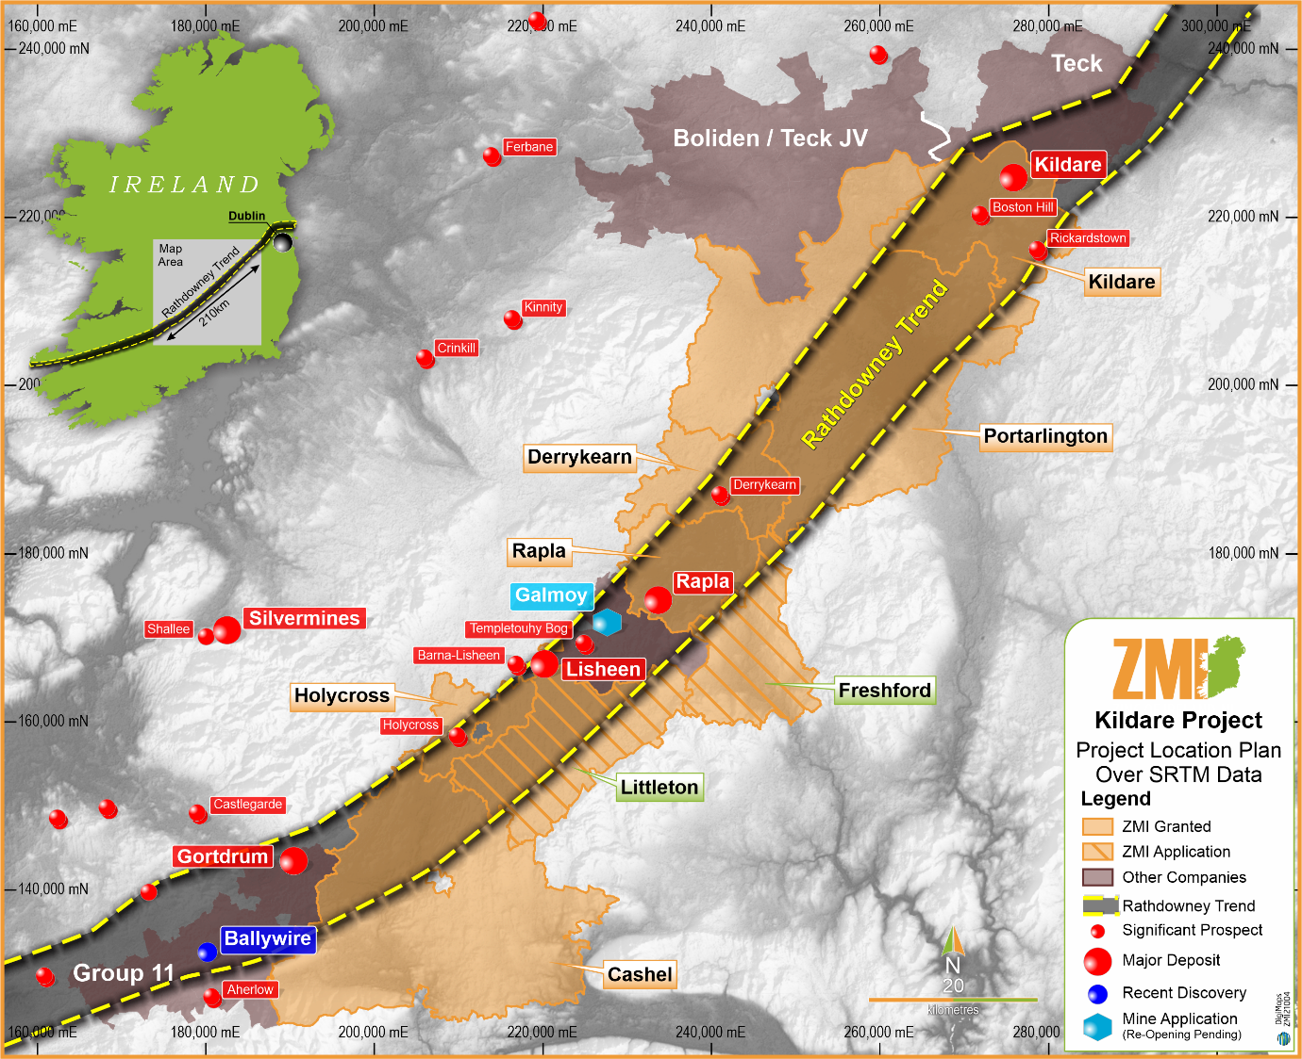
Advantages of Ireland for the Mining Industry
Geological resources (long history of exploration, good scientific knowledge of resources)
Transport links (road, rail, ports)
Telecommunications
Pro-active govt policy (tax incentives)
Technical expertise and labour supply (young, educated, flexible workforce)
Stable economy (investment opportunities)
Democratic system (stability)

Slide 16
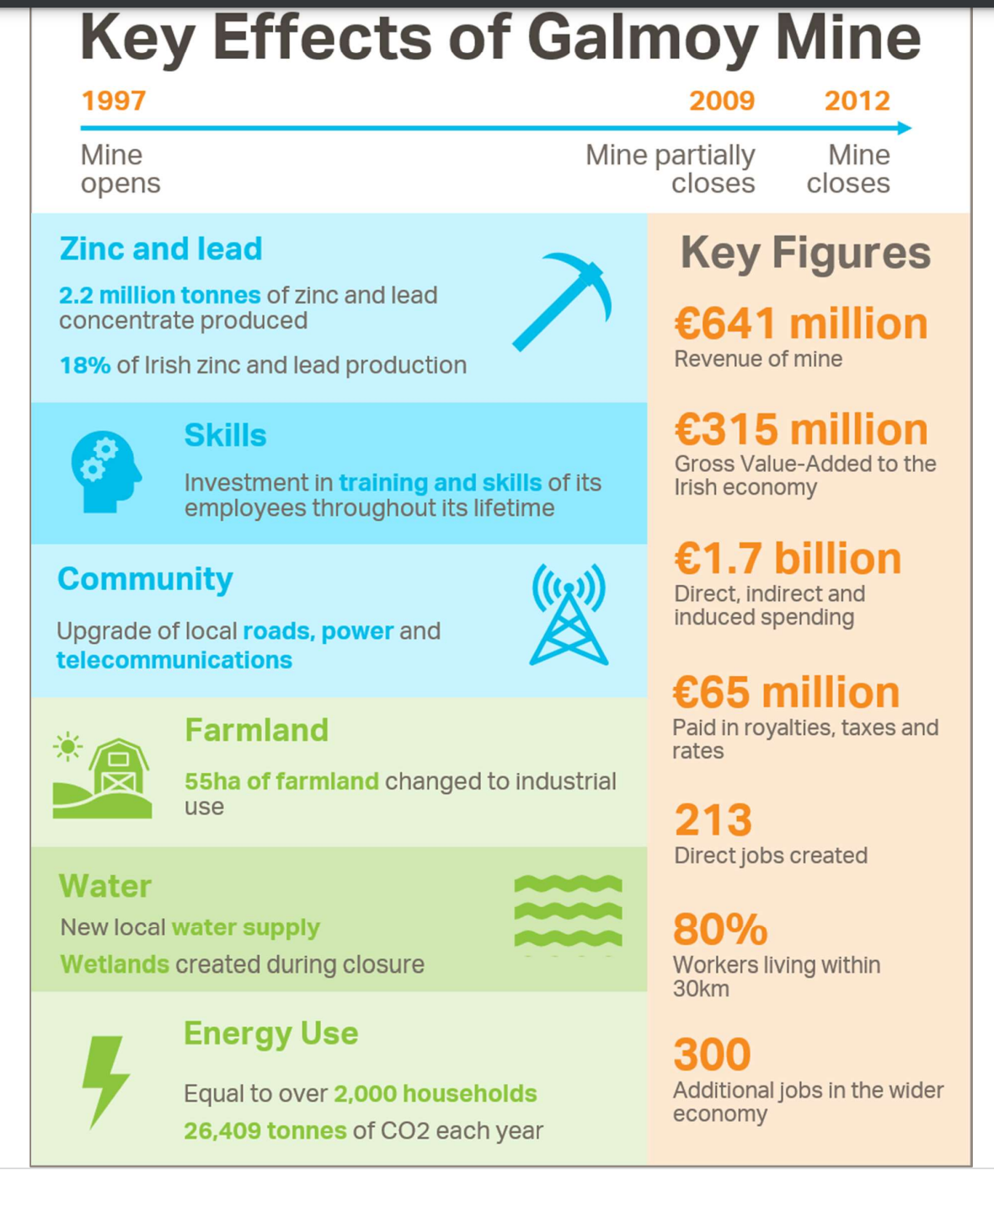
Economic Benefits of Mining to Ireland.
Outputs (Lead, Zinc, Gold)
Employment (Direct, indirect)
Wages (positive multiplier effect)
Taxes (to government)
Rates (local authorities)
Community support (investment in sports facilities)
Regional Development (rural areas in particular)
Resource orientated (industry tied to location)
Reduced dependency on imports

Slide 17
Direct expenditure on mineral exploration in Ireland for the period 2009-2019
234m Euro.
metal mining annually contributes 550m directly to the economy.
a further 230m in gross added value.
over 1,400 regional jobs, many of which are highly skilled.
Mining has a broad regional distribution and has a positive economic and social impact on local communities (wages, provision of infrastructure and services and a positive multiplier effect.).
The industry is also locational specific, or resource orientated and many workers are domiciled within the community or hinterland.
Long-term spin off industries associated with mining include:
geochemical laboratories, drilling companies, design, consultancy, and contracting services companies in the fields of engineering, geology and the environment.

Slide 18
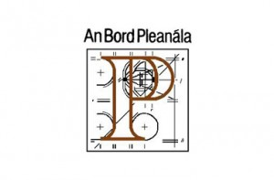
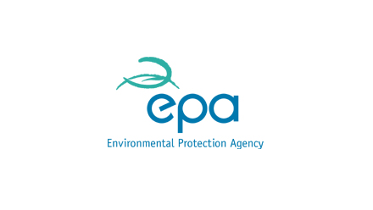


Institutions involved in the Regulation of the Mining Industry in Ireland.
The Minister (the Department) of Communications, Climate Action and Environment.
The Environmental Protection Agency (EPA).
The local Planning Authorities (LA) (County or City Councils).
An Bord Pleanála, the national independent appeals board.

Slide 19
Planning Application Process.
Stage One
Application for a prospecting licence to Dept of ECC.
A Prospecting licence permit is given for a period of 6 years which allows exploration in a specific geographic area. It can be renewed.
It does not give permission to mine
Stage Two
Application for Planning Permission permit (LA)
The applicant must provide detailed information regarding mining operations, processing, waste storage facilities and infrastructural requirements, public consultation is also undertaken.

Slide 20
Stage Three
The next stage is the granting of an Integrated Pollution Control (IPC) licence from the EPA.
Stage Four
The granting of a mining lease or licence from the Department of the ECC
Allows the EPA to regulate environmental performance, including emissions to water and air, noise and vibration impacts and the generation and disposal of waste.
Mining companies are required to plan and provide adequate finance for the closure and after care of mines.

Slide 21
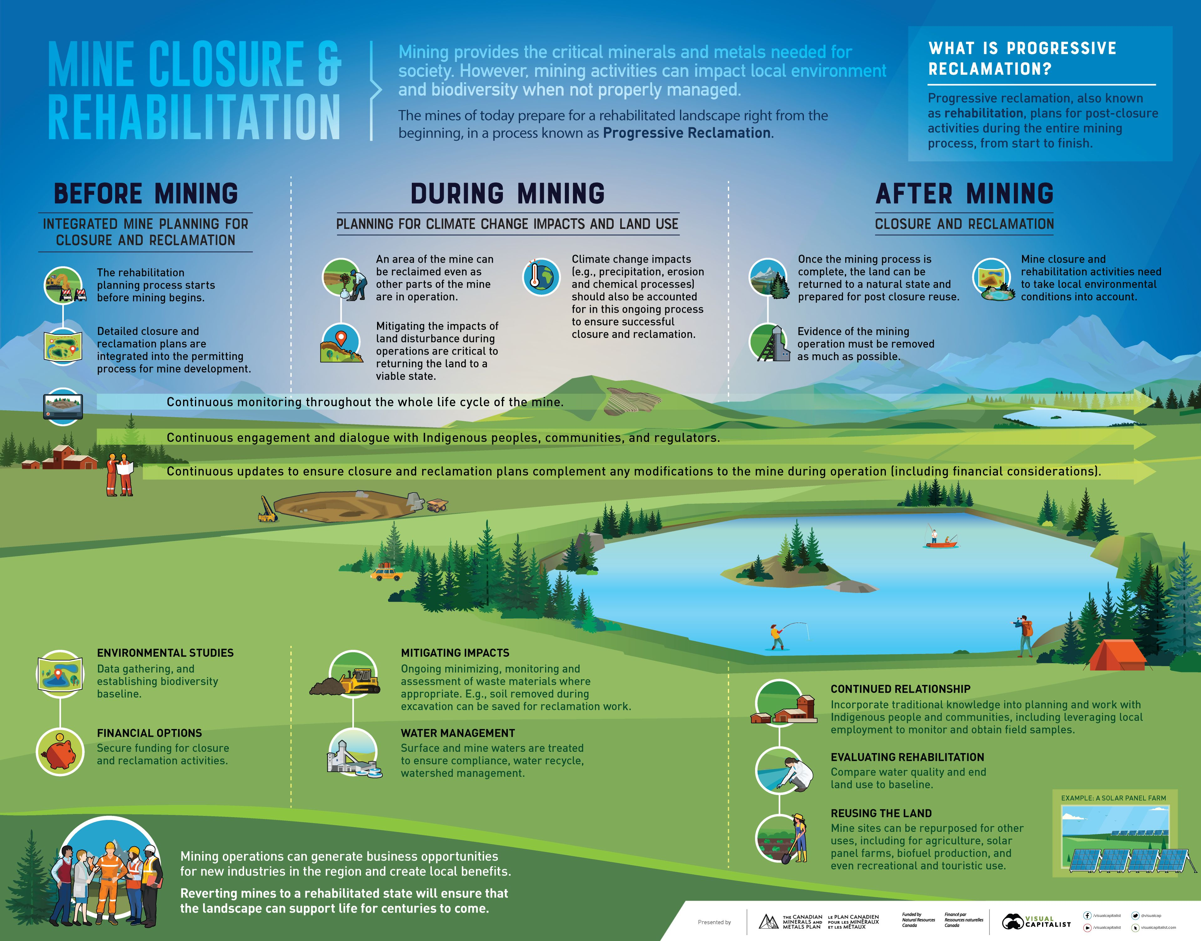

Slide 22
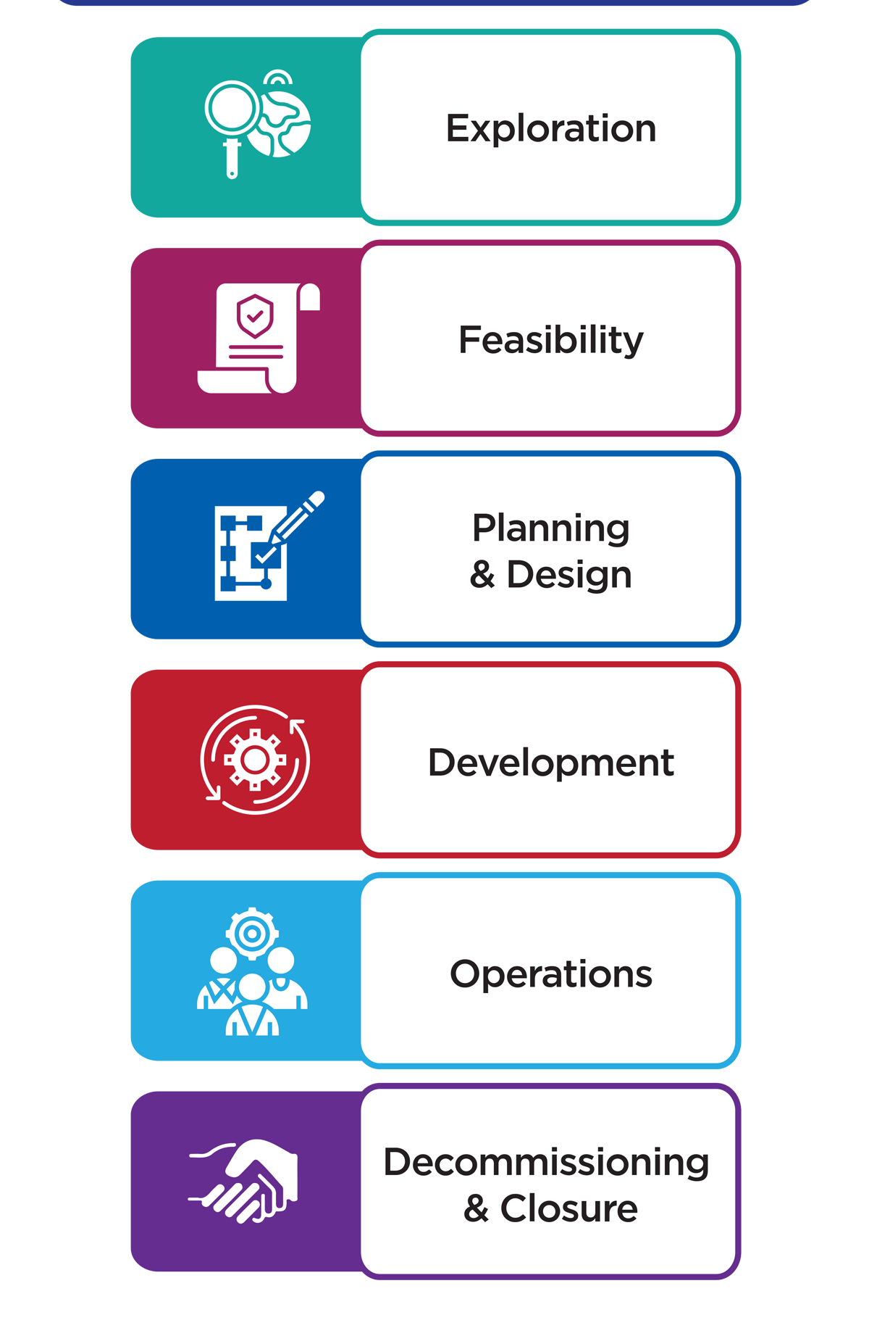
Class Discussion
Is this degree of regulation likely to result in sustainable mining activity ?
Will it encourage investment in the sector ?

Slide 23
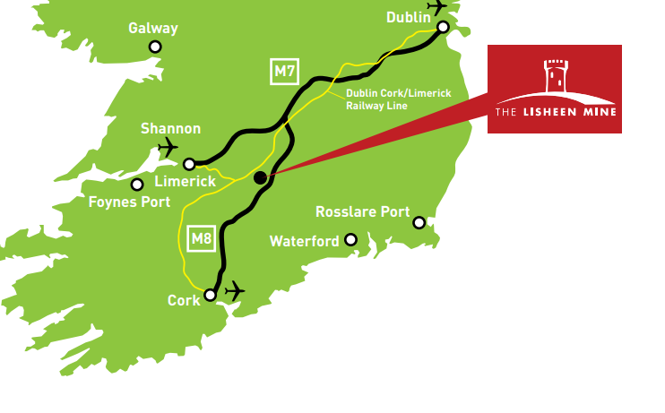
Case Study: Lisheen Mines.
The Lisheen Mine is a former lead and zinc mine located between the villages of Moyne and Templetuohy in North Tipperary.
Stage one
Exploration and Feasibility Study
Lead and Zinc deposits discovered in 1990
Early 1990’s Feasibility Study undertaken which involved,
Technical, Economic, Environmental and Planning studies and Community consultation.

Slide 24
Stage Two
Mine Design and Planning
1995 Submission of an Environmental Impact Statement (EIS) and Planning application to North Tipperary County Council.
Approved in August 1996.
June 1997 An Integrated Pollution Control Licence was issued by the Environmental Protection Agency (EPA).
June 1997 final planning permission granted by An Bord Pleanala.
October 1997 a State Mining Licence was issued by Minister.

Slide 25
Stage Three
Construction and Installation
Construction work started in 1997, went on for 2 years employing up to 700 workers.
Total development cost of 256 million Euro

Slide 26
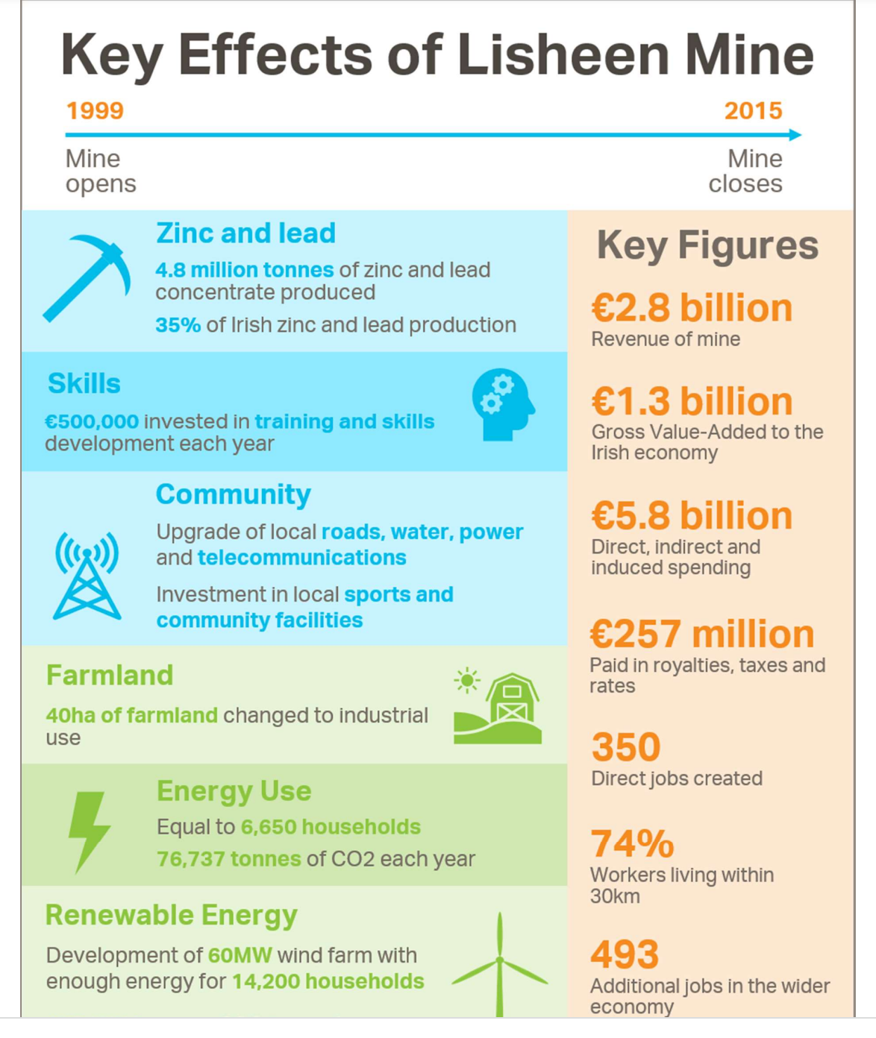
Stage Four
Extraction and Economic Benefits
Production began in October 1999 and continued for 16 years until 2015.
300,000 tonnes of zinc concentrate produced annually.
2.8 Billion in mine revenue.
350 direct jobs.
352 million Euro in wages
500 indirect jobs
Over its 15 years of operation the mine generated
1.3 billion Gross Value Added to the Irish Economy
5.8 billion in direct, indirect and induced spending
257 million to the State in royalties, taxes and rates.

Slide 27
Stage Five
Mine Closure and Aftercare
As part of its Mining Licence, the company was required to a submit Closure, Rehabilitation and Aftercare Management Plan (CRAMP) and to allocated funding for same (27million).
Prior to Closure, Rehabilitation work was undertaking in the tailing ponds (storage of ore residue) and was 60% completed by 2015
After the mine closed in 2015 work continued including:
Backfilling of the underground mine
Clearing and removal of buildings and equipment
Removal of ground contaminated with Lead and Zine
Rehabilitation of tailing ponds to agricultural land
All work undertaken was closely monitored by relevant authorities.

Slide 28
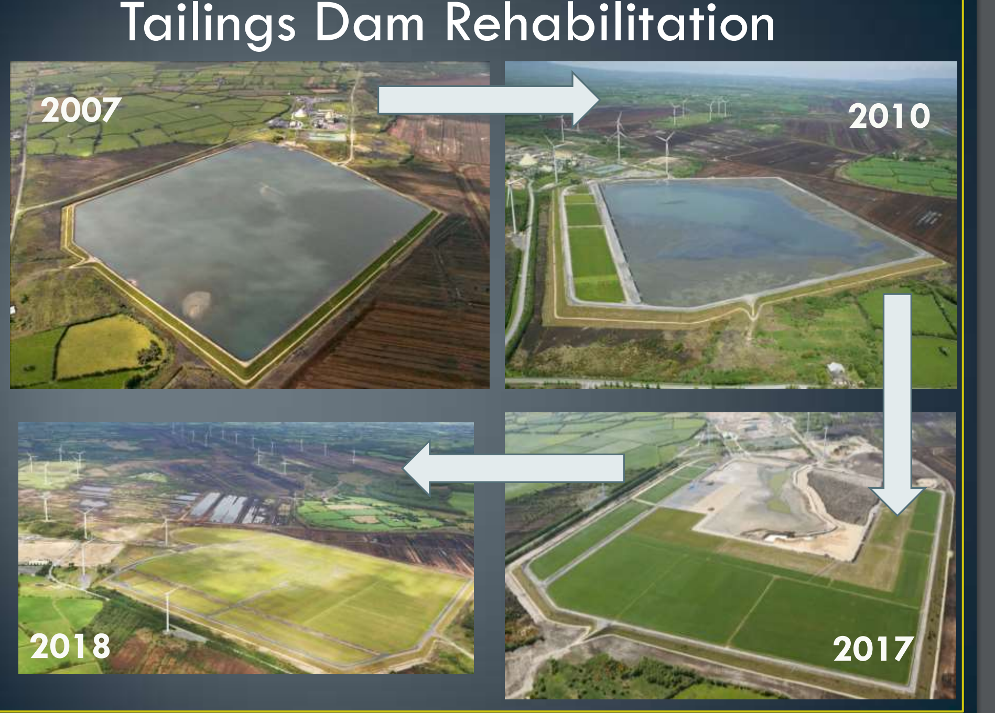

Slide 29
Post-Mining Land Use
Mine infrastructure removed
Wetlands to trap water runoff
Buildings used to support other economic activities
Campus for National – Bio economy – production of renewable biological resources and their conversion into food, feed, biobased products and bioenergy.
Development of 44 wind Turbines which supply electricity to power 70,000 homes (size of Galway City)
Improvement of road network, telecommunications, new fresh water supply, investment for local sport facilities and community hall
Reskilling and upskilling of mines workforce.

Slide 30
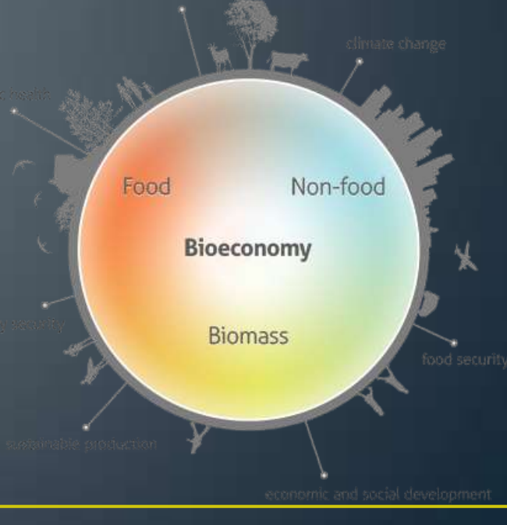
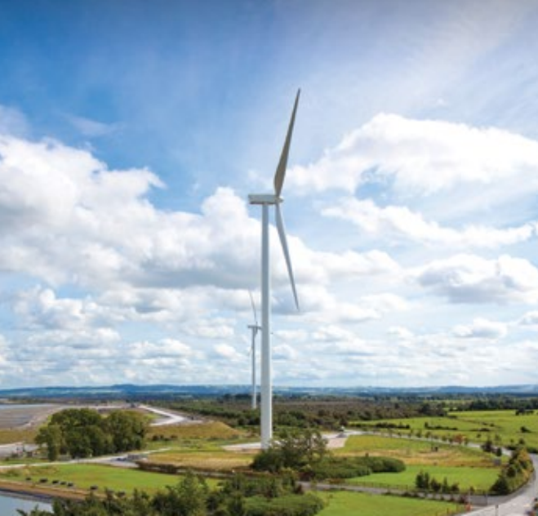

Slide 31
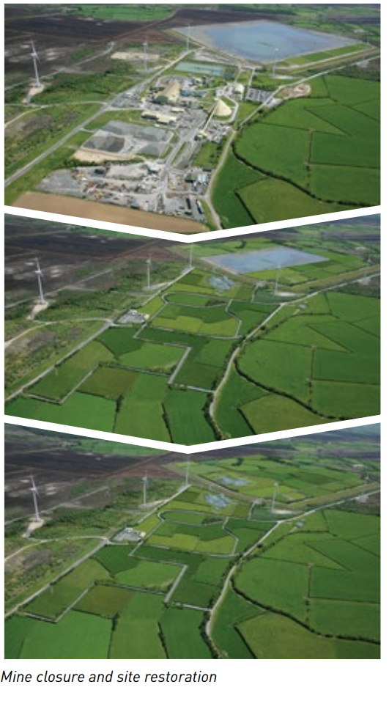

Slide 32
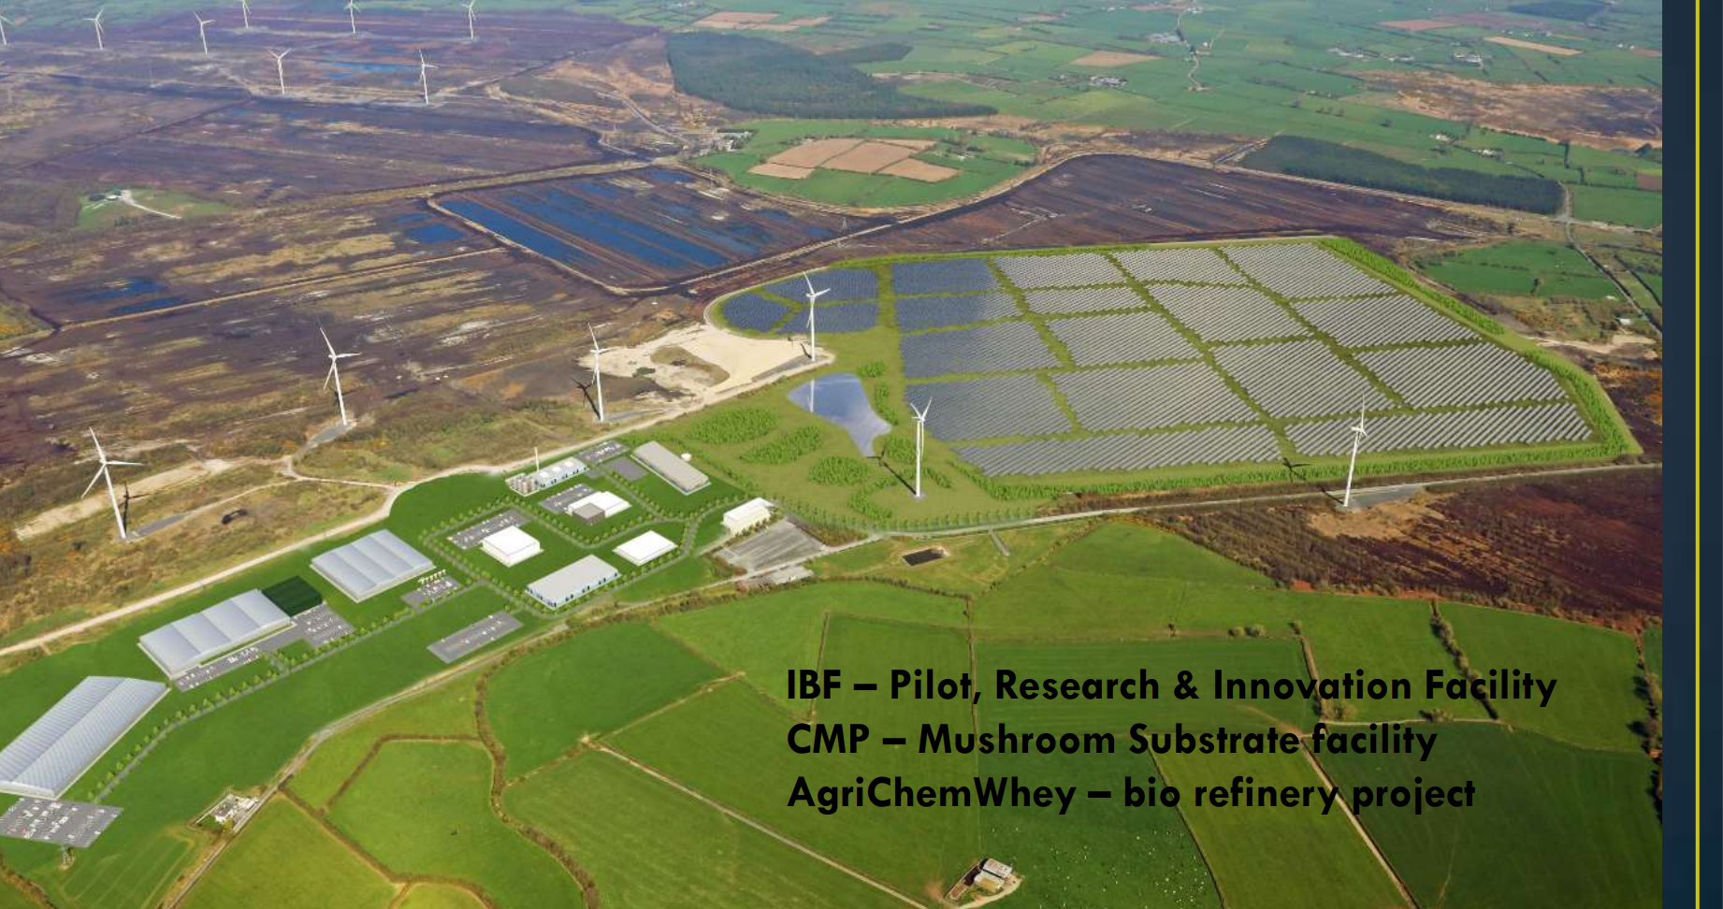

Slide 33
Key Question :
Is Lisheen Mine an example of sustainable Mining ?
Overall sustainable mining is possible if efforts are made to enhance the benefits of mining activity and to reduce or mitigate negative impacts.
Involvement of the local community in the process allows companies a “social licence to operate”.

Slide 34
Future of Mining In Ireland
Geological Survey of Ireland.
“Ireland can offer more. Strong potential exists to further explore for zinc, in addition to other known metals critical to the green economy which are also found on the island including silver, gold, copper, lead, lithium, barytes, antimony, cobalt, platinum group elements and rare earth elements”

Slide 35
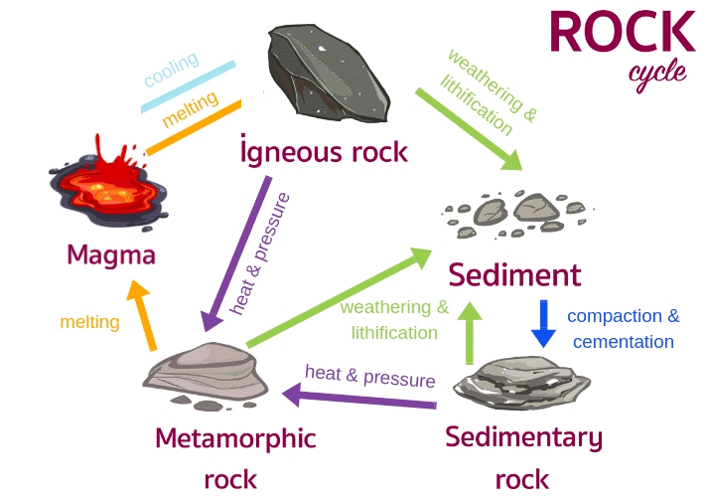
Examination Questions in past papers.
Human Interaction with the rock cycle: Physical Section: 30 marks.
Higher Level
2009, 2010, 2011, 2013, 2015, 2018, 2020, 2022 ?
Ordinary Level
2010, 2013, 2014, 2016, 2017, 2018, 2019, 2020, 2021

Slide 36
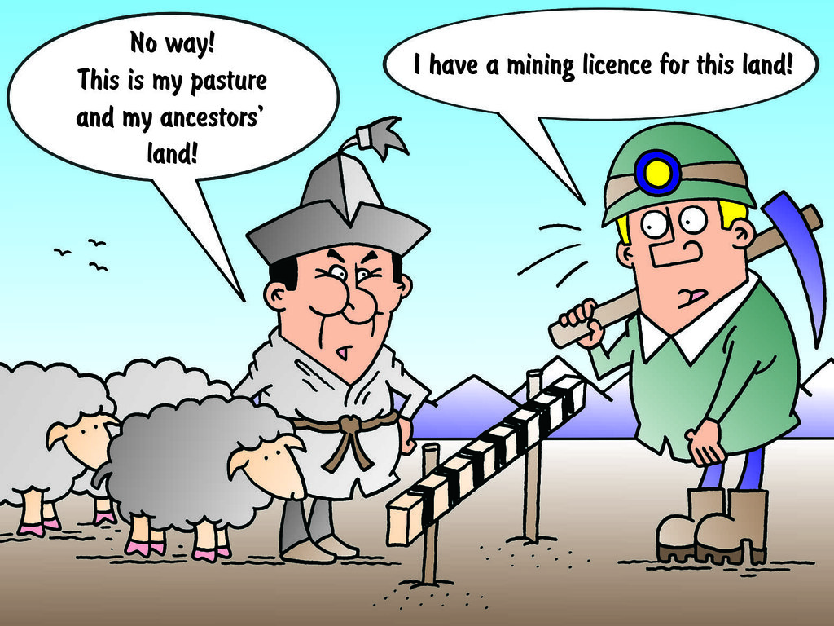
Examination Questions in past Higher level papers.
Conflict of Interests: Economic Elective :30 marks
2009, 2010, 2012, 2014, 2016, 2018, 2021
Ordinary Level
2010, 2012, 2014, 2016, 2018, 2020

Slide 37

Examination Questions in past Higher level papers.
Environmental impacts of economic activities: Economic Elective: 30 marks.
2018
2015

