Slide 1
L/I: look at how tectonic processes have shaped the landscape in our area
Starter: write a list of ways in which tectonic activity affects any landscape.

Slide 2
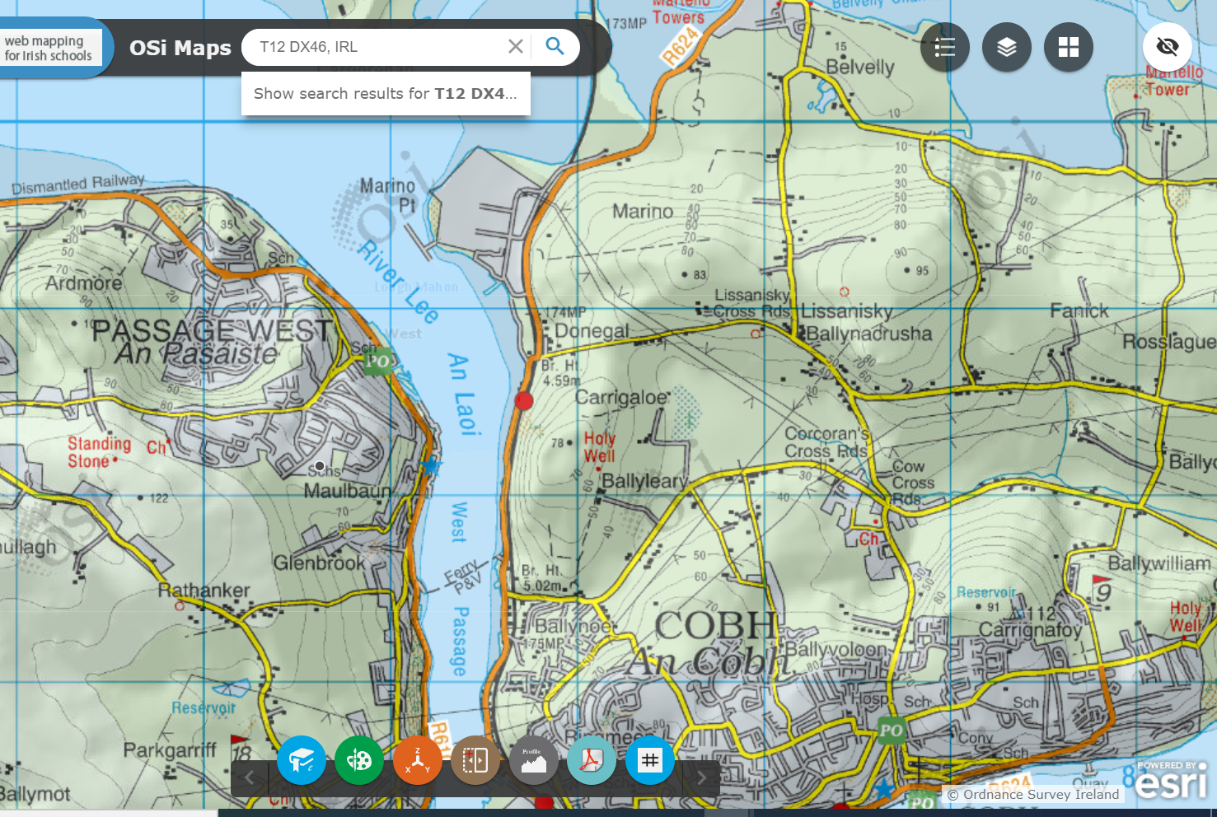
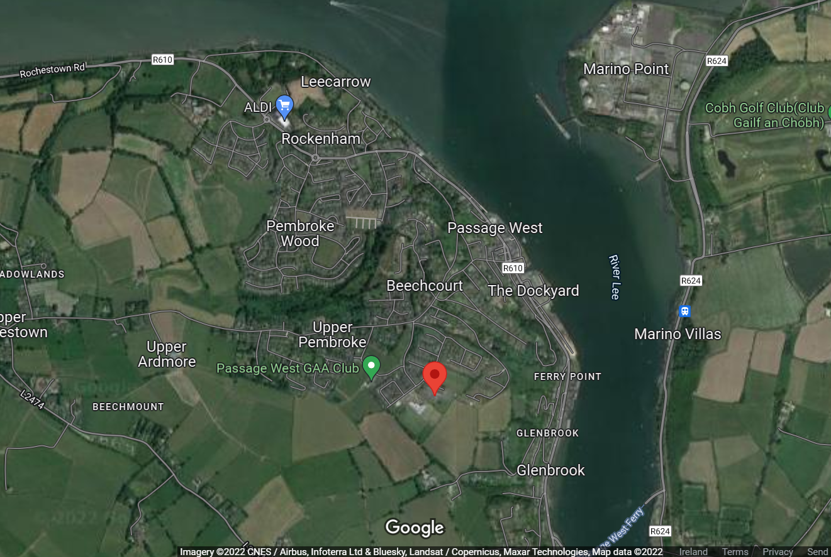
Let's look at our area.....
Write down three points about the topography of Passage West

Slide 3
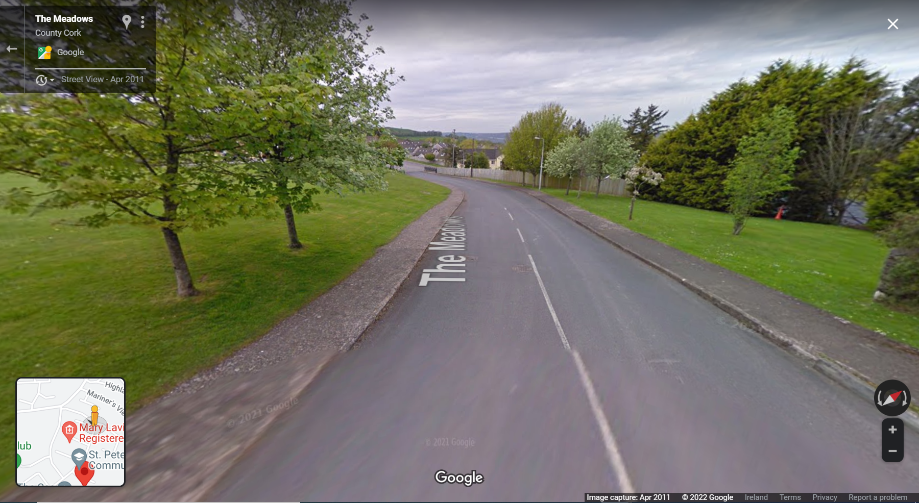

Slide 4
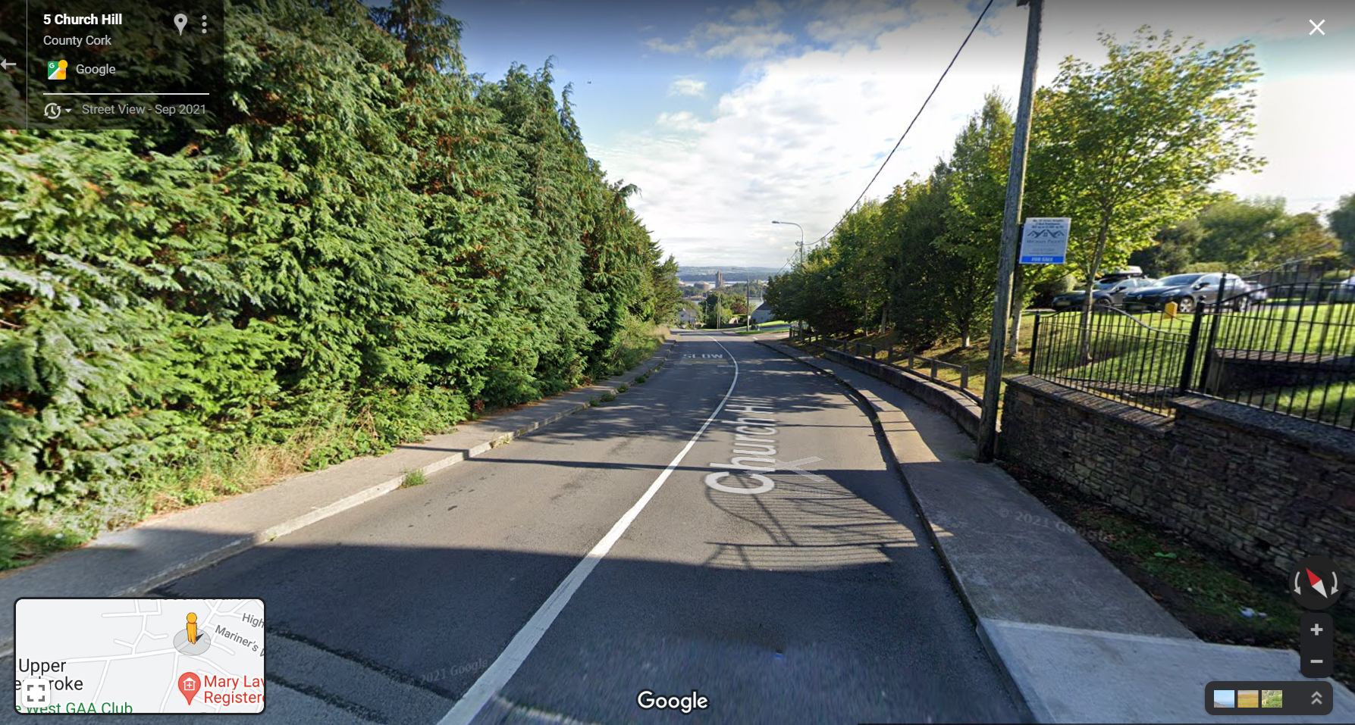

Slide 5
Where are we located on this map?
Carboniferous limestone
Late Devonian/Early Carboniferous mudstone (Cork Beds)
Devonian old red sandstone

Slide 6
Write a brief account of how the rocks were formed
Sandstone | Limestone | Mudstone
 |  | Formed when clay particles are deposited in water. Mud is buried at the bottom of lakes, seas and/or rivers and is compacted by the sediment or other rocks on top of it Water is squeezed out by the compression and mudstone is formed.

Slide 7
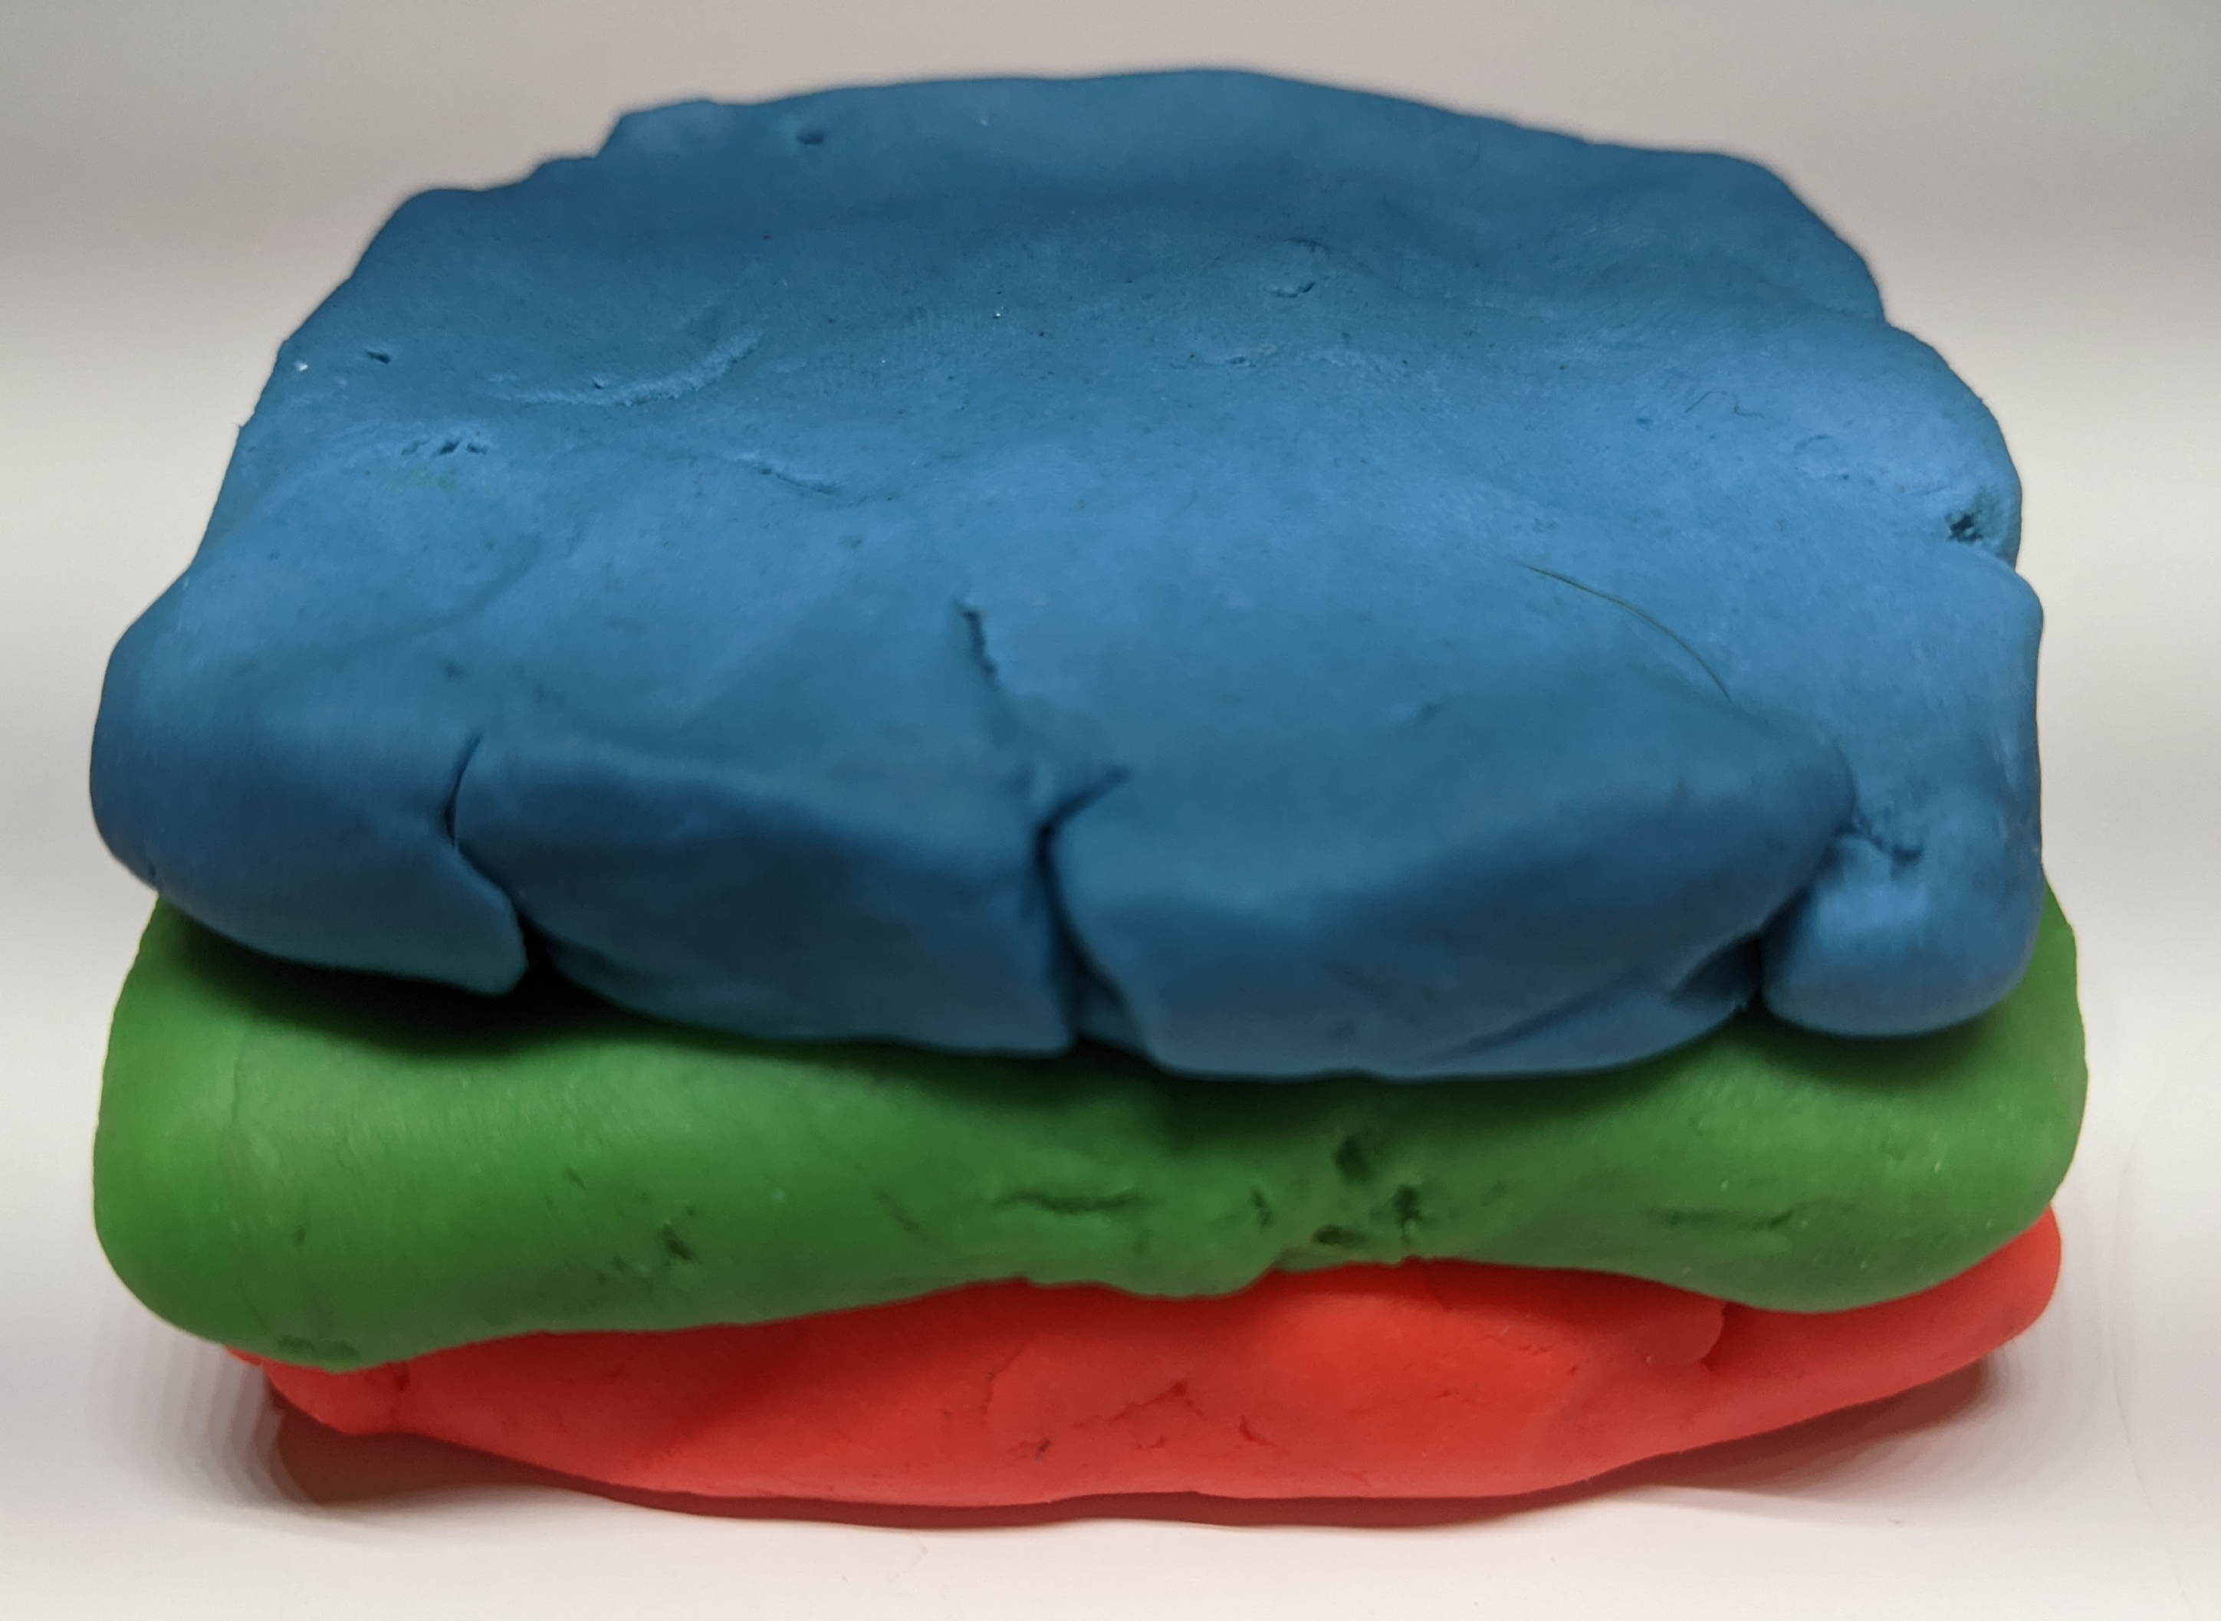
Create your rock layers
Taking three different colours of play doh build the rock layers that are in our area (oldest at base).
Blue- Carboniferous Limestone
Green - Late Devonian/Early Carboniferous (Cork Beds) sandstone and mudstone
Red – Devonian (Old Red) Sandstone
Notes:
Before flick onto the next slide could ask how we get all three rock types exposed at the surface if they are laid down in layers?
Topography is very minor compared to the thickness of the units so it is not so much that valleys can cut into the layers below - need something to move the rocks - generally only see more than one rock at the surface if have folding and/or faulting (they usually go together)

Slide 8
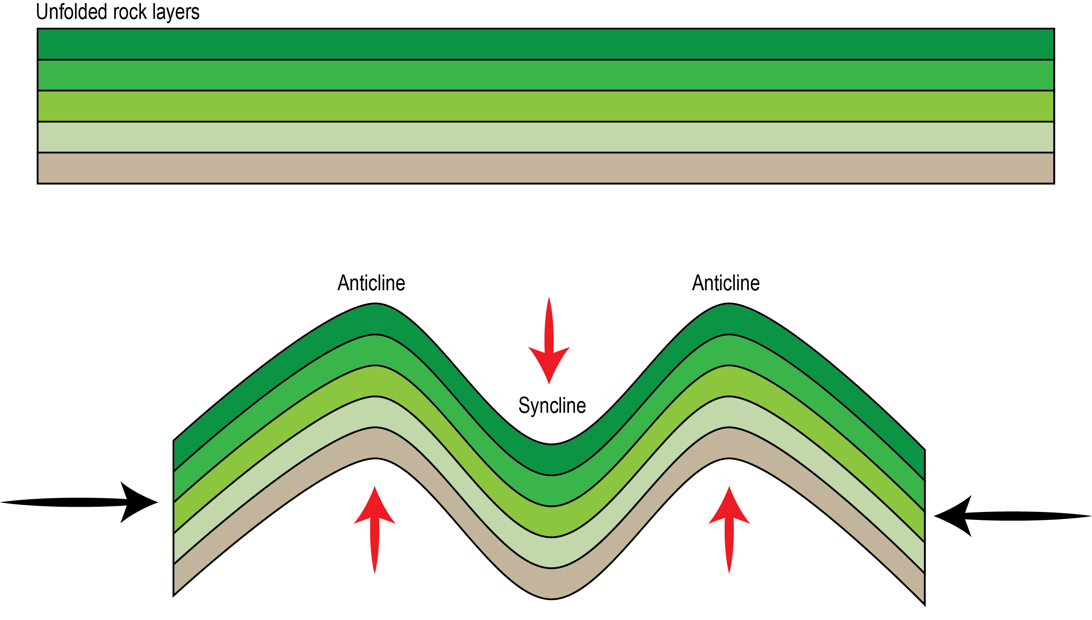
Folds
Folds form when the layers of rock are compressed by tectonic forces, causing them to bend up wards or downwards
Rock layers fold upwards (looks like a bump) = anticline
Rock layers fold downwards (looks like a dip) = syncline
Mountains are formed by folding
Image: Alaska Earthquake centre

Slide 9
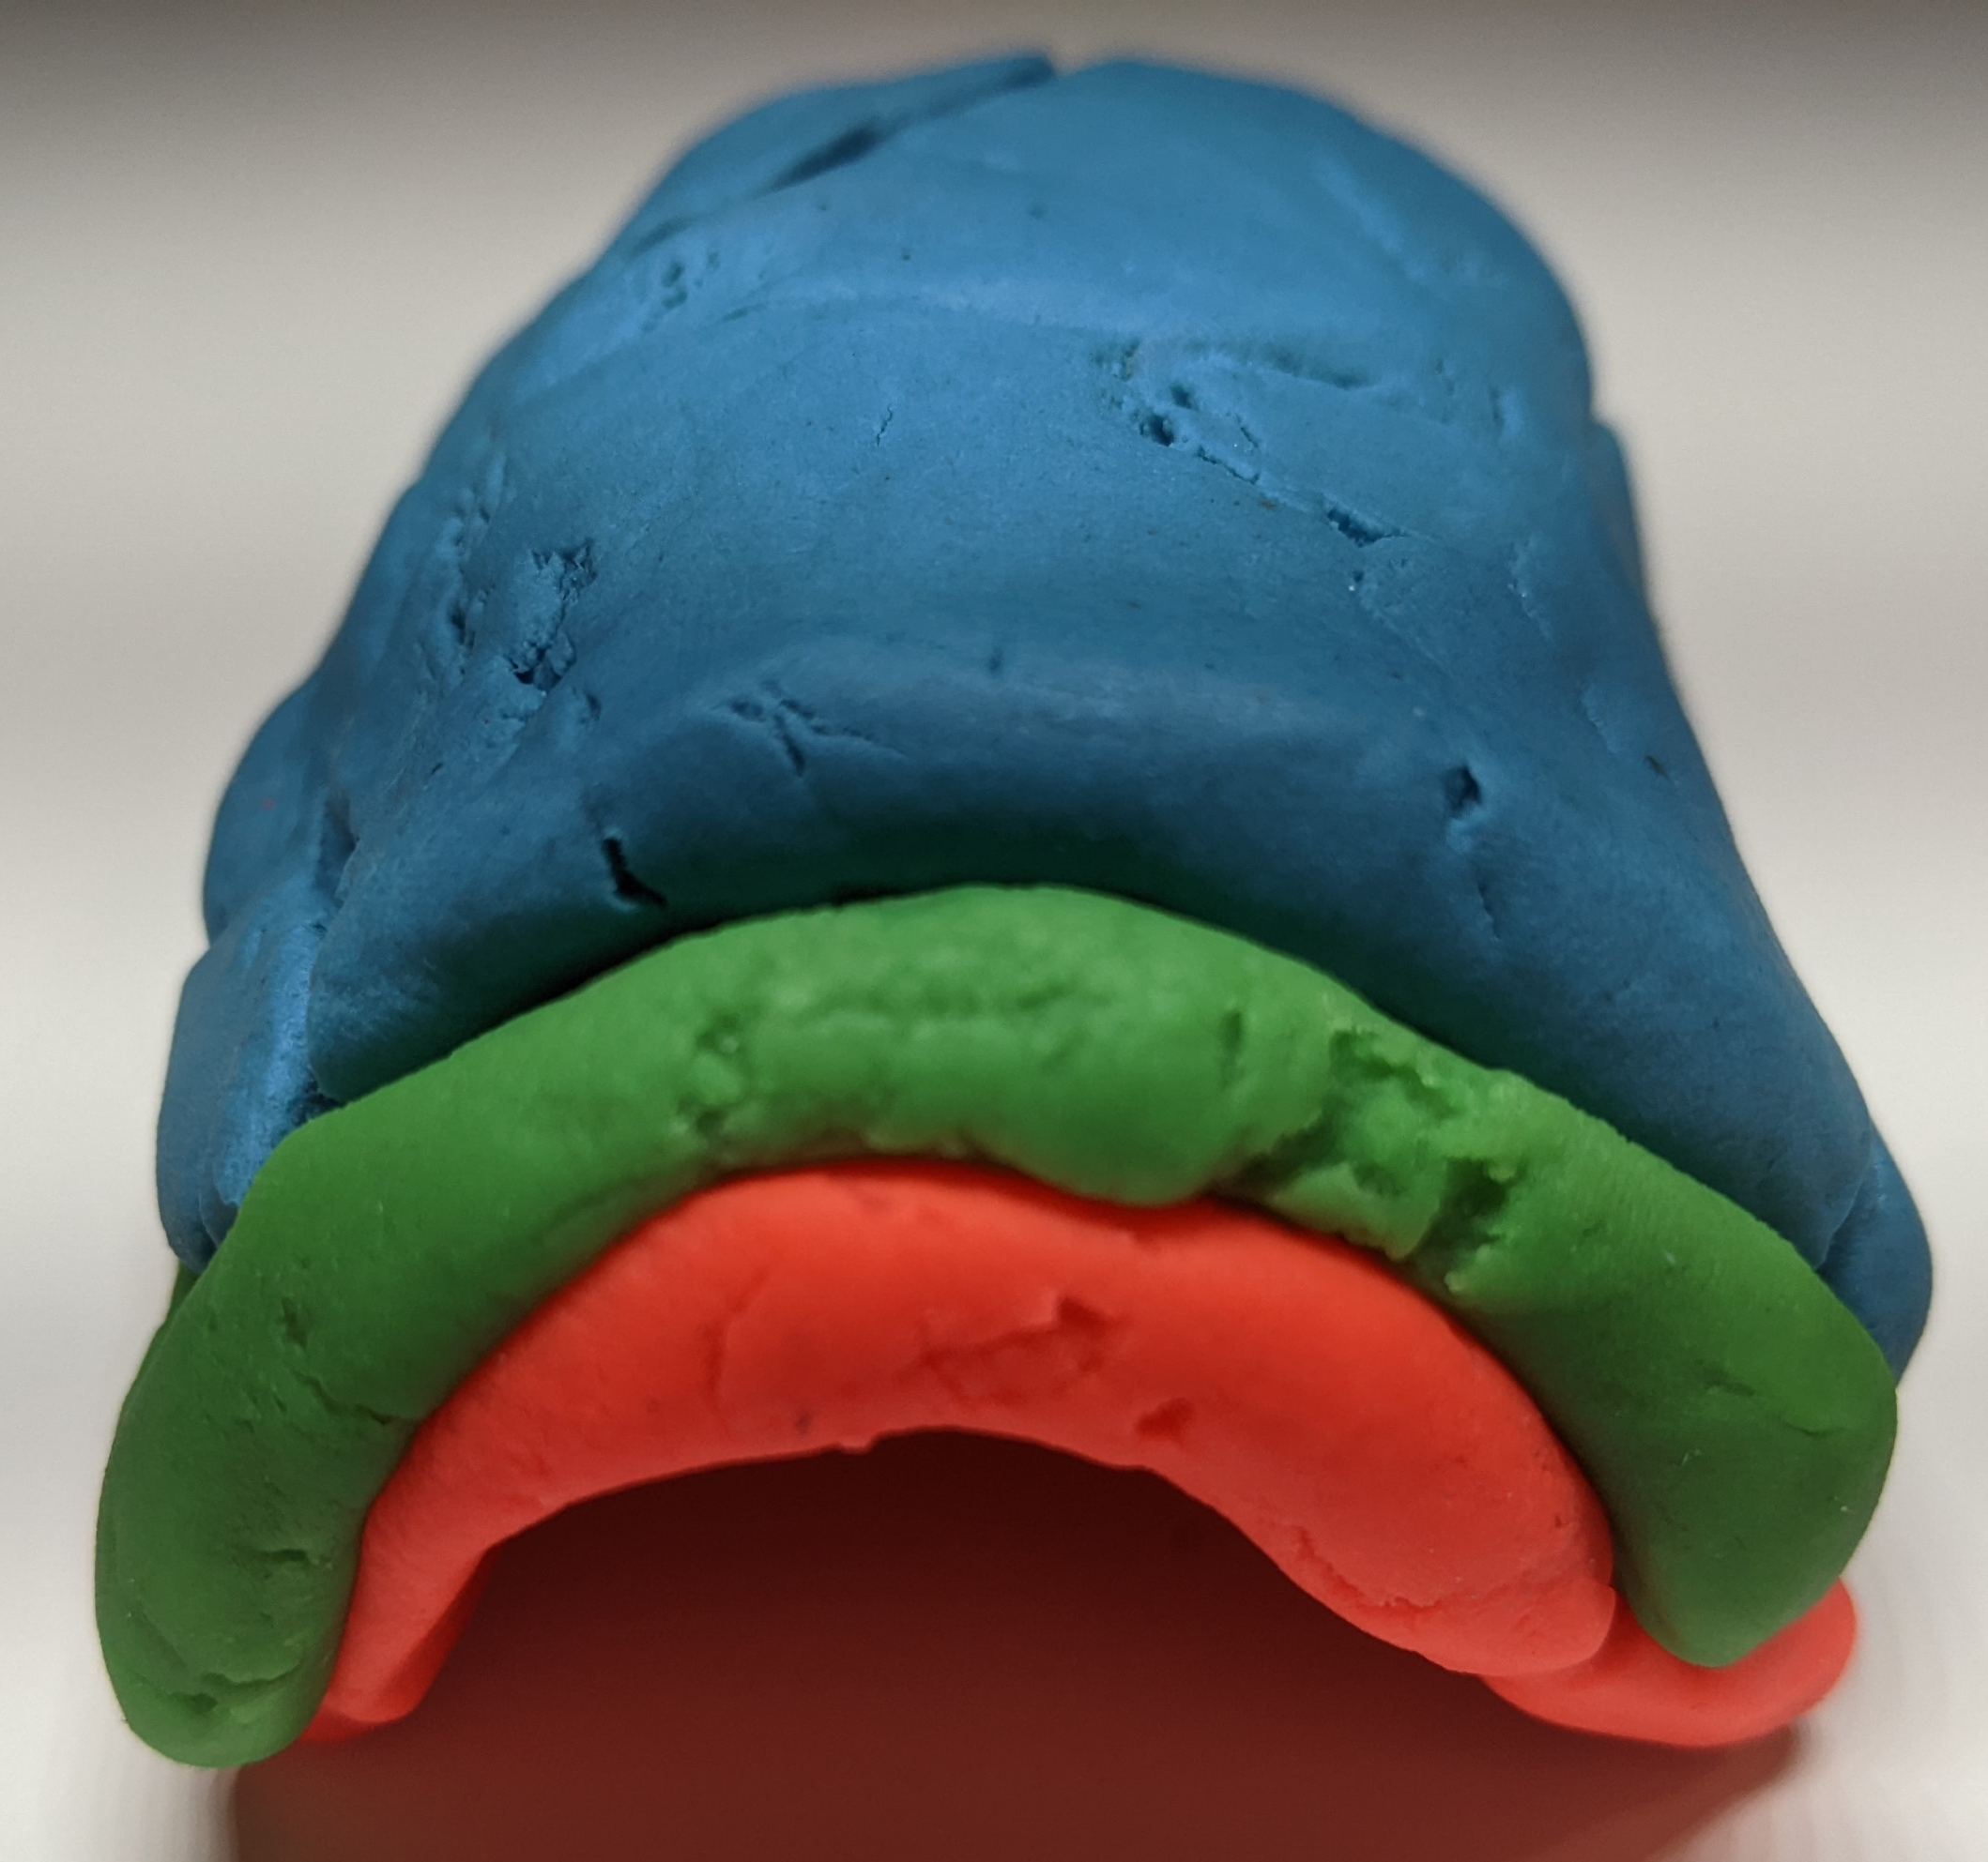
Folds
Create an anticline and syncline with your play doh

Slide 10
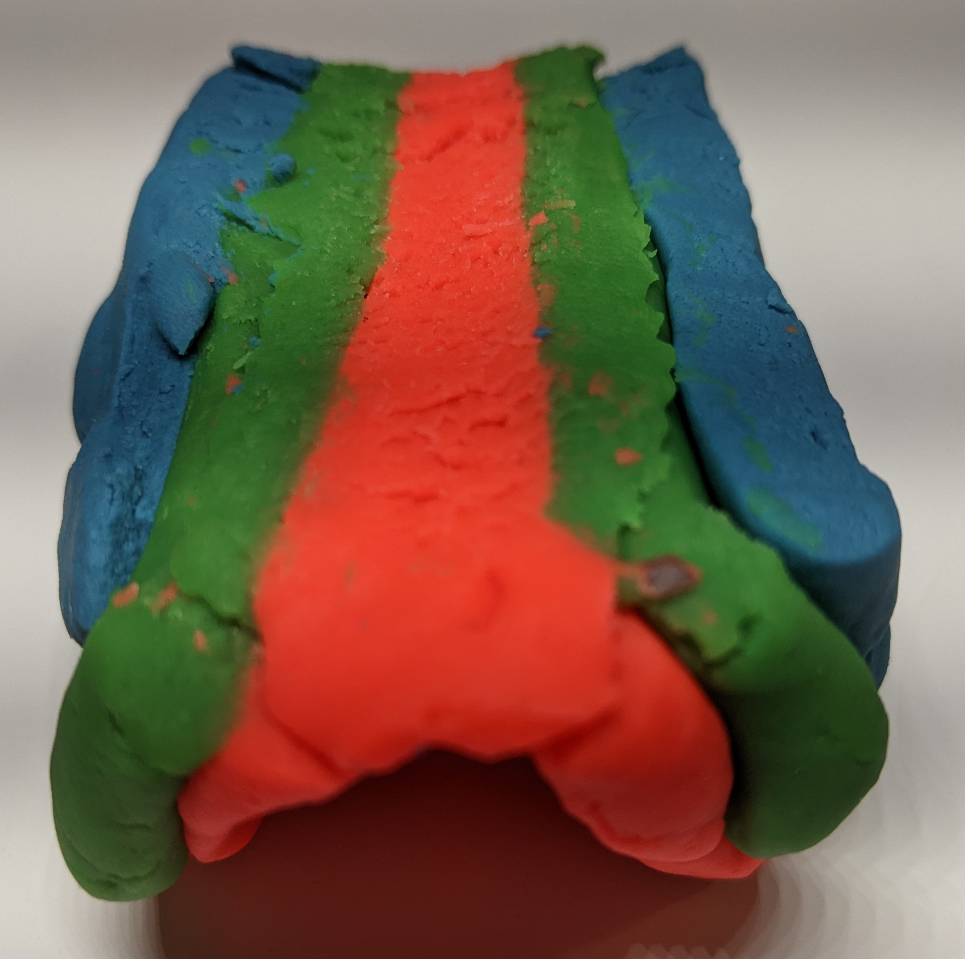
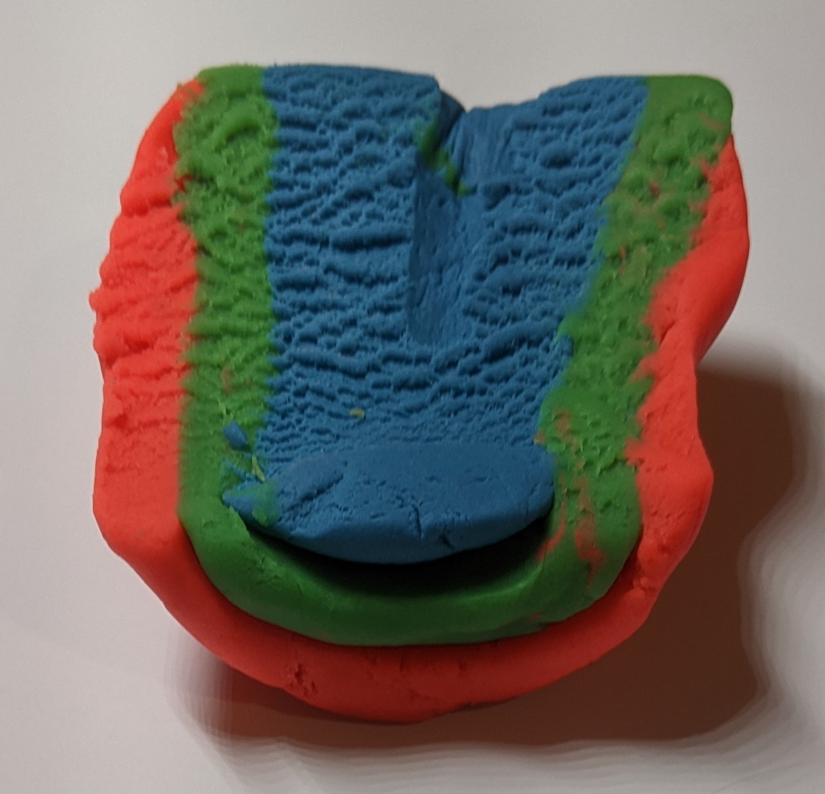
Anticline
Syncline
Notes:
Maybe ask them how they differ?
Both have all three layers exposed at the surface
Order is different – for anticline the lowermost outcrops at the fold hinge and the youngest at the edge – other way around for the syncline
Dip is different – layers dip away from the hinge in the anticline and towards in the syncline
Put these folds aside – we will need them layer

Slide 11
Which one looks like our area?
Carboniferous limestone
Late Devonian/Early Carboniferous mudstone (Cork Beds)
Devonian old red sandstone
What are these?

Slide 12
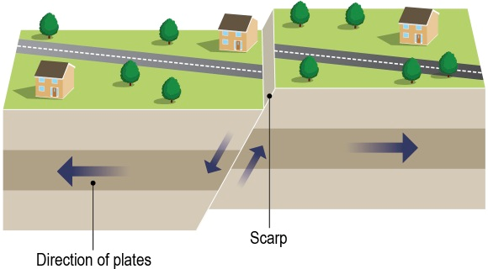
Try creating the following faults.....
Normal fault
Formed by tension when the earth's crust pulls apart.
Note the changes to the crust (play doh)
Picture reference: Horizons Book 1, Tara Fitzharris, 2016

Slide 13
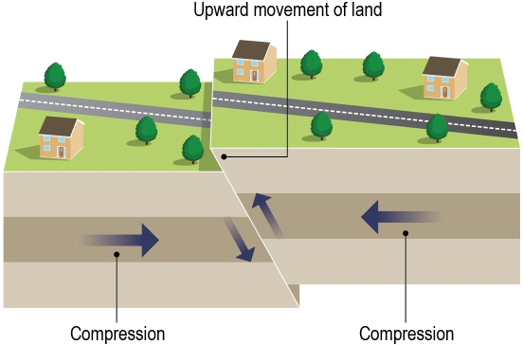
Reverse Fault
Formed by compression (when the earth's crust pushes together
Note the changes to the crust (play doh)
Picture reference: Horizons Book 1, Tara Fitzharris, 2016

Slide 14
Create a new set of rock layers
Taking three different colours of play doh build the rock layers that are in our area (oldest at base).
Blue- Carboniferous Limestone
Green - Late Devonian/Early Carboniferous (Cork Beds) sandstone and mudstone
Red – Devonian (Old Red) Sandstone
Notes:
Before flick onto the next slide could ask how we get all three rock types exposed at the surface if they are laid down in layers?
Topography is very minor compared to the thickness of the units so it is not so much that valleys can cut into the layers below - need something to move the rocks - generally only see more than one rock at the surface if have folding and/or faulting (they usually go together)

Slide 15
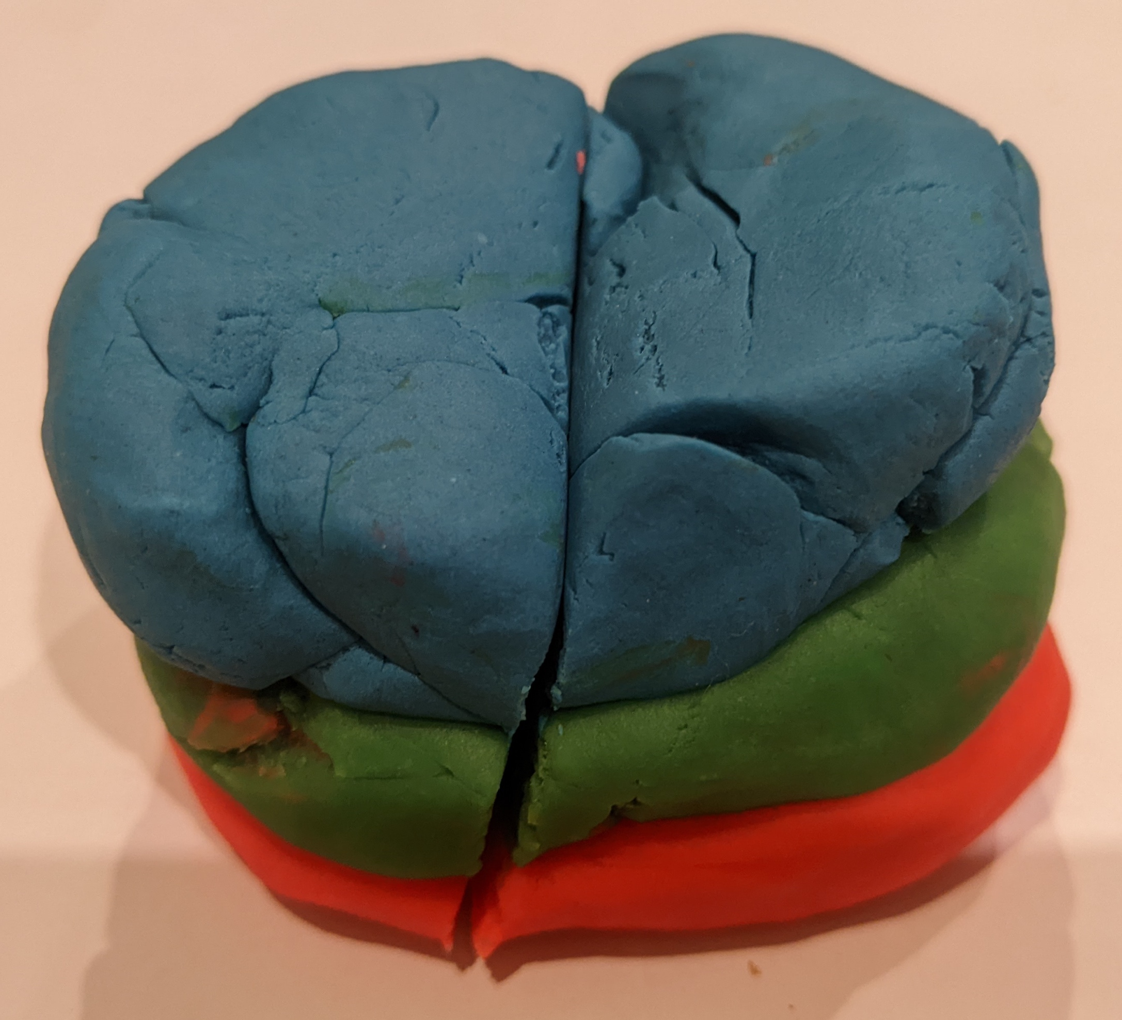
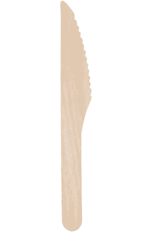
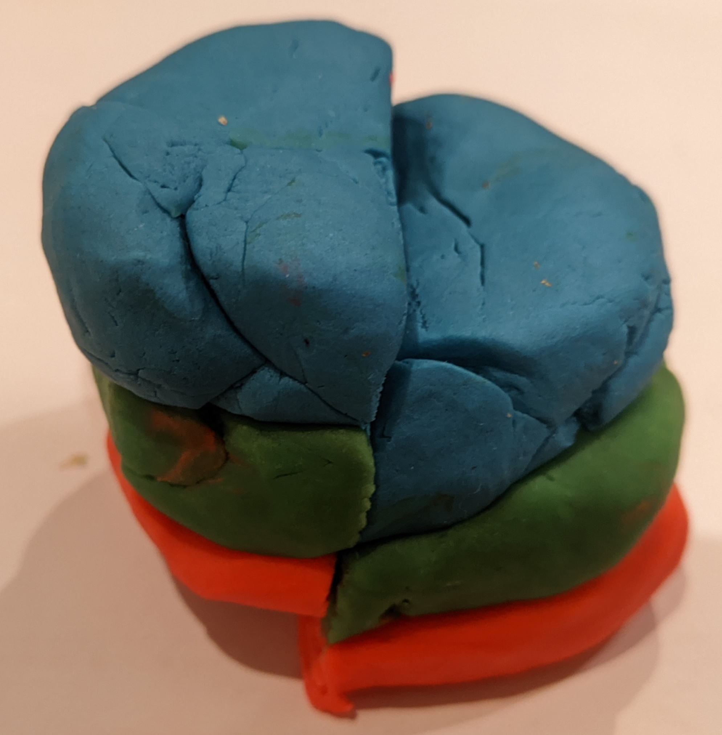
Faults
"Fault' this sequence by cutting sub-vertically
Create a normal or reverse fault by moving upmost half down or up
Notes:
Normal is down
Reverse is up
Photo shows reverse

Slide 16
Faults
Erode the landscape by slicing off the top of the playdoh

Slide 17
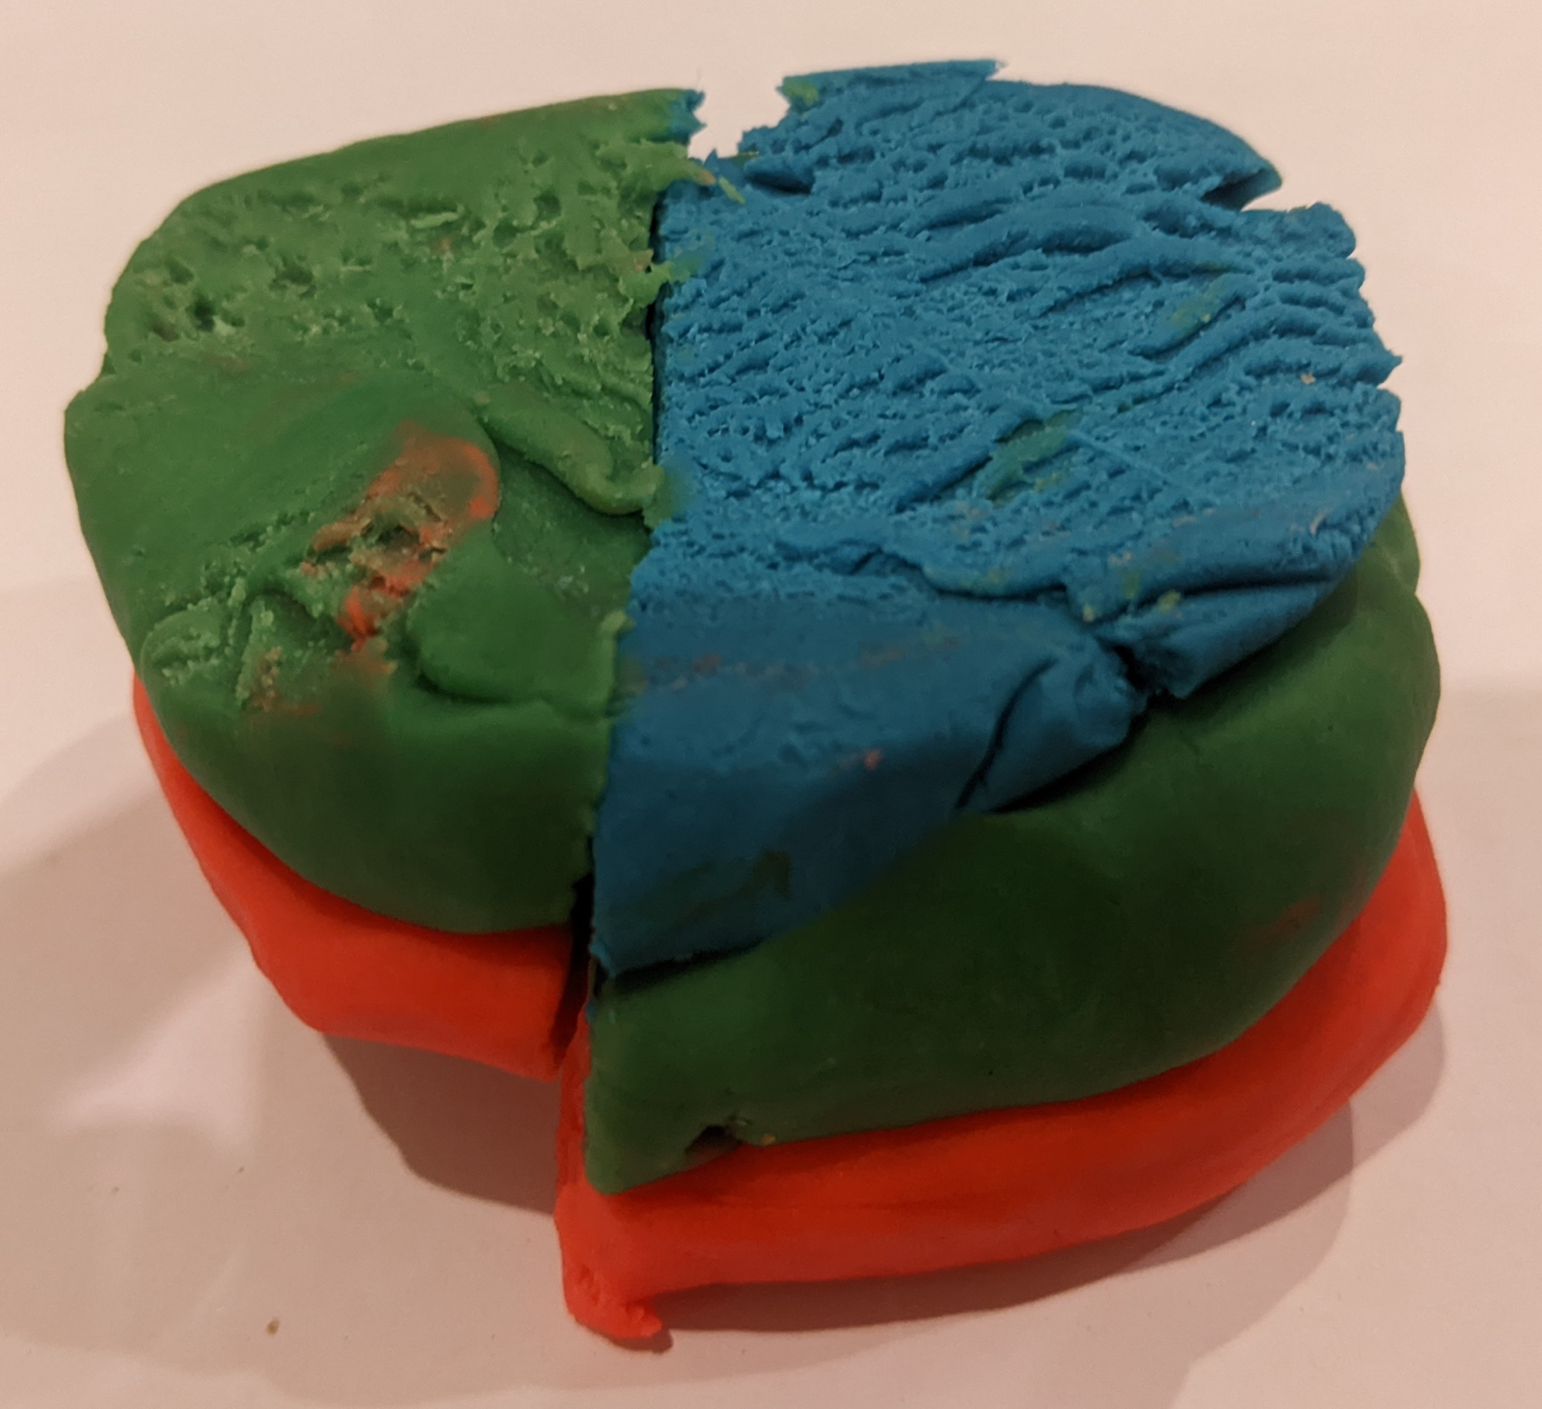
Faults allow different rock layers to appear next to each other
Upthrown side has older rocks (from deeper) at the surface
Notes:
Upthrown side has older rocks (from deeper) at the surface

Slide 18
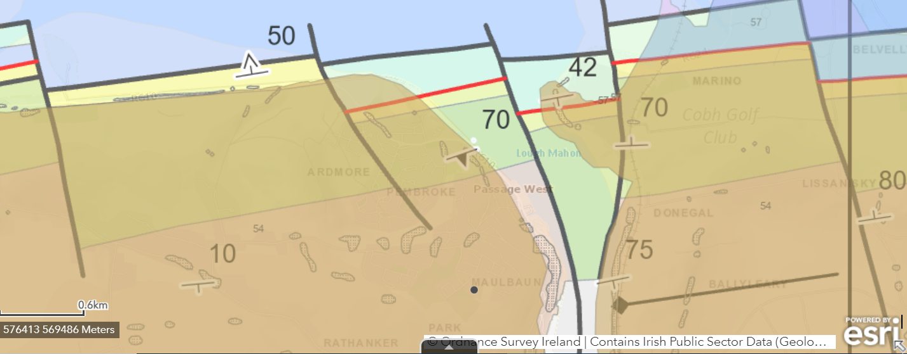
Let's look at how folding and faulting has affected our landscape
Follow the link and use the legend to distinguish what the lines mean...
Our school

Slide 19


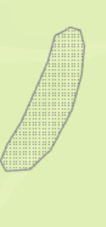

Using GSI in your groups, define the following symbols
1
2
3
5
4

Slide 20
Looking at our area and knowing what each line means can you create our landscape using your play-doh?
Notes:
Decide whether we have anticline or syncline
Add a reverse or normal fault to it

Slide 21
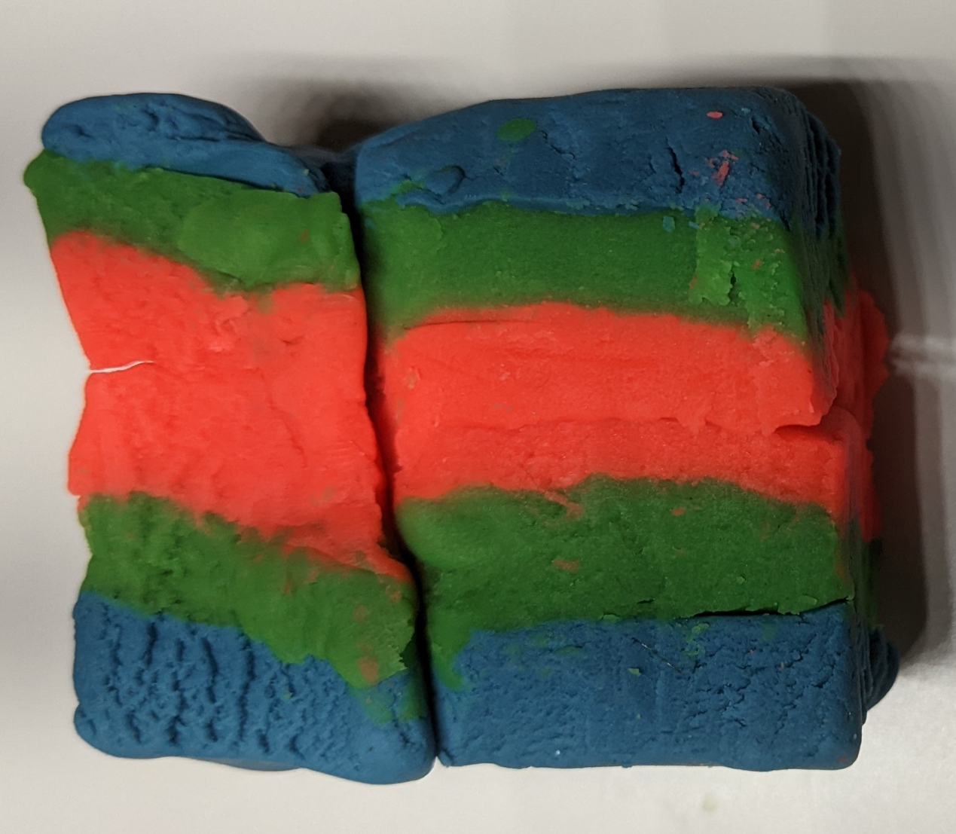
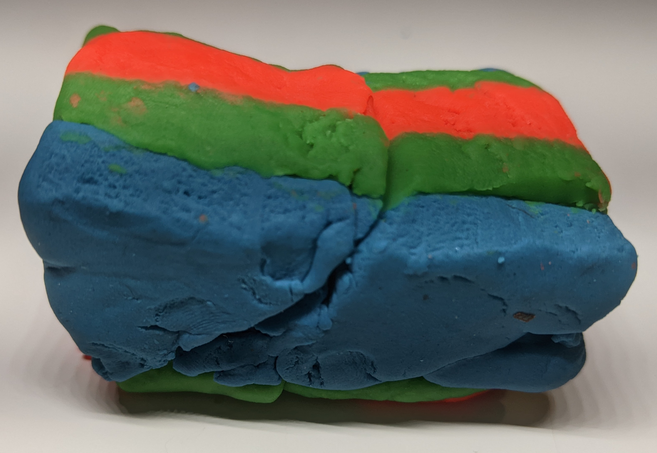
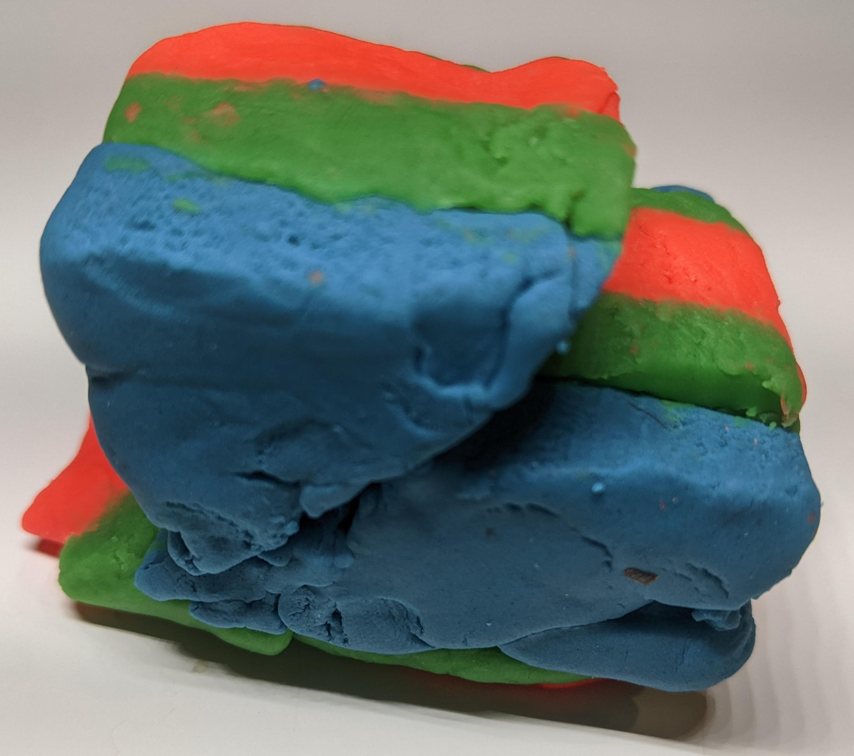
Combining the folds with the faults
Can see the offset

Slide 22
Carboniferous limestone
Reverse fault
Late Devonian/Early Carboniferous mudstone (Cork Beds)
Devonian old red sandstone
wider
narrower

Slide 23
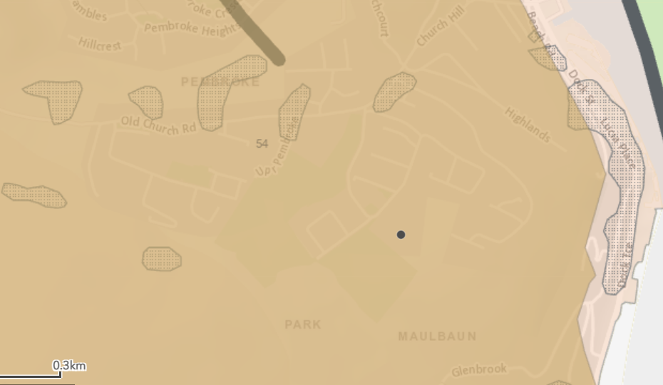
Homework
Check out your local area on GSI maps look for areas that look like the places the arrows are pointing to. Go explore and try and find where these areas are near you and take a picture.

Slide 24
